Slide 1
DYNAMICS AND BIFURCATIONS IN VARIABLE TWO SPECIES INTERACTION MODELS IMPLEMENTING PIECEWISE LINEAR ALPHA-FUNCTIONS
Katharina Voelkel
April 26, 2012

Slide 2
Types of Interspecies Interactions
Name of Interaction | Effect of Interaction on Respective Species
Neutralism | 0 / 0
Competition | - / -
Predator-Prey or Host-Parasite | + / -
Mutualism | + / +
Commensalism | 0 / +
Ammensalism | 0 / -

Slide 3
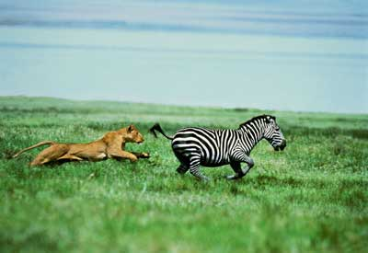
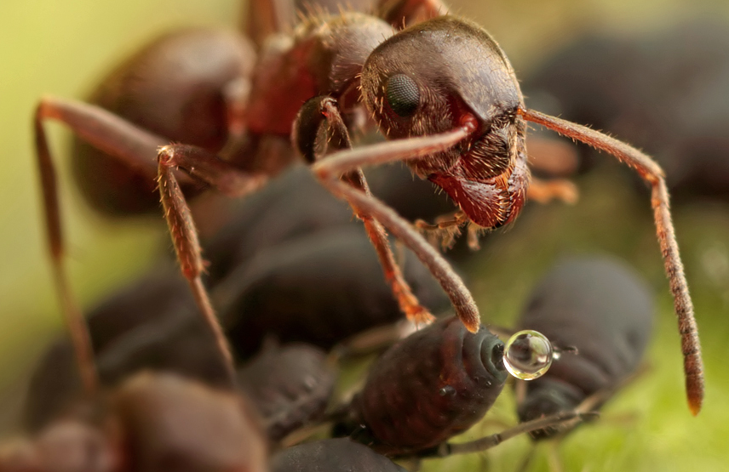
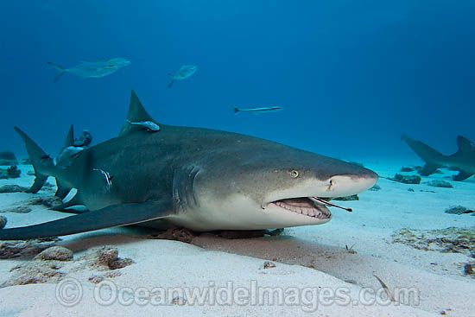
Static vs. Variable
http://animalog.tumblr.com
http://mattcolephotography.blogspot.com
http://www.britishcheloniagroup.org.uk

Slide 4
Roots of Interaction Modeling
Lotka-Volterra Equations:
Generalization:

Slide 5
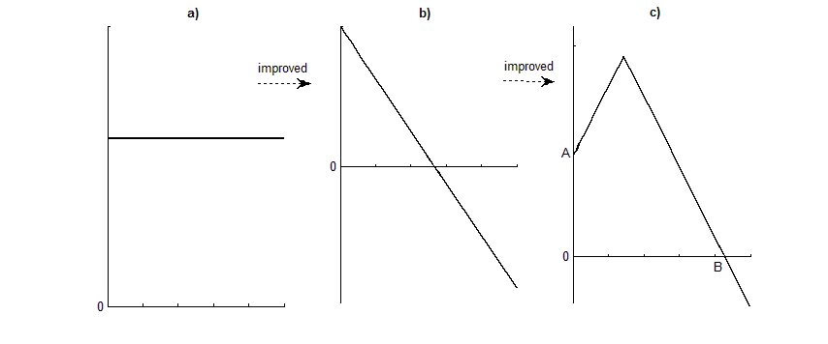
Extension of α-Functions
α
α
α
(N₀, Y₀)
N
N
N
Lotka – Volterra Generalization (Zhang et al.) New Model
N
N
N

Slide 6
The Models Studied
α
(N_{0,} Y₀)
N

Slide 7
Previous Research
B. Zhang, Z. Zhang, Z. Li, Y. Tao. „Stability analysis of a two-species model with transitions between population interactions.” J. Theor. Biol. 248 (2007): 145–153.
M. Hernandez, I. Barradas. “Variation in the outcome of population interactions: bifurcations and catastrophes.” Mathematical Biology 46 (2003): 571–594.
M. Hernandez. “Dynamics of transitions between population interactions: a nonlinear interaction α-function defined.” Proc. R. Soc. Lond. B 265 (1998): 1433-1440.
local stability of equilibria,
graphical analysis of saddle-
node bifurcations

Slide 8
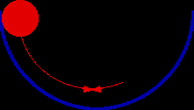
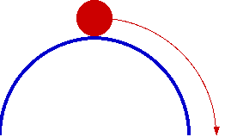
Equilibrium Points
Occur whenever dx/dt = 0 and dy/dt = 0 simultaneously
Stable vs. Unstable
http://motivate.maths.org

Slide 9
Classifying Equilibria
Linearization of system given by Jacobian Matrix:
J=$\left[\begin{matrix}\frac{∂\left(\frac{dx}{dt}\right)}{∂x} & \frac{∂\left(\frac{dx}{dt}\right)}{∂y} \\ \frac{∂\left(\frac{dy}{dt}\right)}{∂x} & \frac{∂\left(\frac{dy}{dt}\right)}{∂y}\end{matrix}\right]$
The eigenvalues of the Jacobian Matrix evaluated at an equilibrium point determines the behavior around the equilibrium point.

Slide 10
Linearization
Jacobian Matrices for the four systems are:

Slide 11
Boundary Equilibria
(0, 0): D_{A} =$\left[ \begin{matrix}r & 0 \\ 0 & R\end{matrix}\right]$ = D_{B} = D_{C} = D_{D} → unstable Node
( $\frac{r}{k}$, 0): Saddle for system [A] and [D]
Saddle or stable Node for system [B] and [C]
(0, $\frac{R}{K}$): Saddle for system [A] and [C]
Saddle or stable Node for system [B] and [D]

Slide 12
Interior (aka Coexistence) Equilibria
Focus on System [A]:
Equilibrium P₃ = (x₃,y₃) has to satisfy:
0 = r-kx+(ay +b)y (1)
0 = R-Ky+(cx +d)x (2)

Slide 13
(1) defines the parabola x = $\frac{1}{k}\left(ay^{2}+by+r\right)$ .
The roots of this parabola are: y_{1,2} = $\frac{−b±\sqrt{b^{2}−4ar}}{2a}$
Vertex = minimum; (x₁,y₁)=( $\frac{1}{k}(r−\frac{b^{2}}{4a})$,$\frac{−b}{2a}$) → QIII or QIV
(2) defines the parabola $y=\frac{1}{K}\left(cx^{2}+dx+R\right)$.
The roots of this parabola are: x_{1,2} = $\frac{−d±\sqrt{d^{2}−4cR}}{2c}$
Vertex = minimum; (x₂,y₂) = ($\frac{−d}{2c}$, $\frac{1}{K}(R−\frac{d^{2}}{4c}$) → QII or QIII

Slide 14
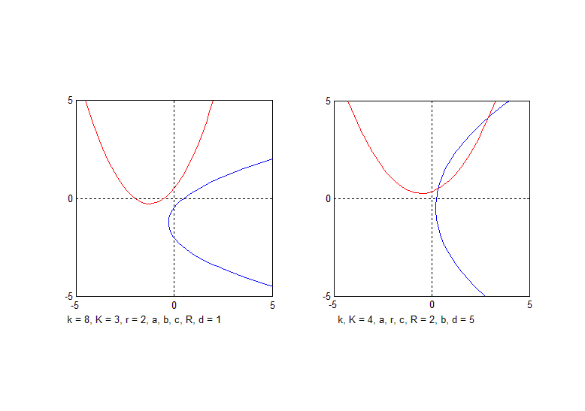
# of Coexistence Equilibria = # of Intersections of Nullclines

Slide 15
Classifying Coexistence Equilibria
Slopes of Nullclines:
From (1): x = $\frac{r}{k}+ \frac{ay^{2}}{k}+\frac{by}{k} \overset{⇒}{} \frac{dx}{dy}=\frac{2ay+b}{k}$
m₁ = $\frac{k}{2ay+b}$; m₂ = $\frac{2cx+d}{K}$ Mutualism
In general:
m₁ > 0 and m₂ > 0 → Mutualism
m₁ < 0 and m₂ < 0 → Competition
m₁ < 0 and m₂ > 0 (or vice versa) → Host-Parasite

Slide 16
Classifying Coexistence Equilibria (cont’d)
At an interior equilibrium point P₃ = (x₃,y₃), the Jacobian D_{A} simplifies to:
D_{A} = $\left[\begin{matrix}−kx & \frac{kx}{m_{1}} \\ Km_{2}y & −Ky\end{matrix}\right]$
Characteristic equation:
Eigenvalues: $λ_{1,2}=\frac{−Ky−kx}{2}±\sqrt{{(\frac{Ky+kx}{2})}^{2}−\left(1−\frac{m_{2}}{m_{1}}\right)Kkxy}$
If $\frac{m_{2}}{m_{1}}>1$ → P₃ is a saddle
If $\frac{m_{2}}{m_{1}}<1$ → P₃ is a stable node
P₃ is never a focus nor of center type

Slide 17
 | System [A] | System [B] | System [C] | System [D]
P₀ = (0, 0) is a: | Unstable node | Unstable node | Unstable node | Unstable node
P₁ = ( $\frac{r}{k}$ , 0) is a: | Saddle | Saddle or stable node | Saddle or stable node | Saddle
P₂ = (0, $\frac{R}{K}$) is a: | Saddle | Saddle or stable node | Saddle | Saddle or stable node
Number of coexistence equilibria P₃ = (x₃, y₃) | 0 – 2 | 0 - 3 | 0 – 1 | 0 – 1
P₃ = (x₃, y₃) is a: | Saddle or stable node | Saddle, stable node, or focus | Saddle, stable node, or focus | Saddle, stable node, or focus
Relationship between species indicated by equilibria P₃ | Mutualism | Mutualism, competition, or host-parasite | Mutualism or host-parasite | Mutualism or host-parasite

Slide 18
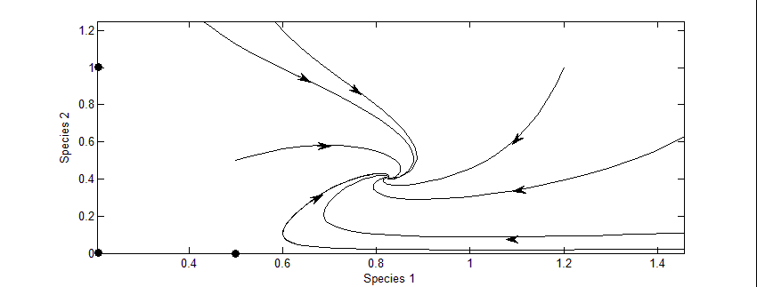
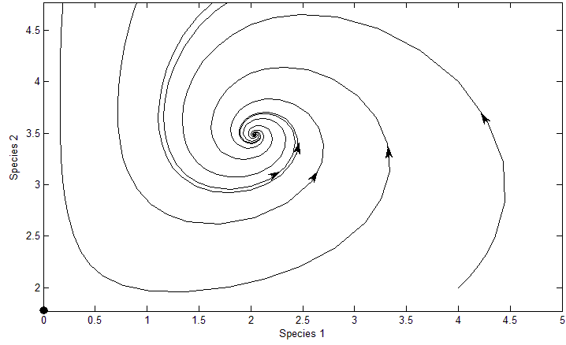
Stable Node Coexistence Equilibrium (System [B])
H-P
Stable Focus (System [D])
H-P

Slide 19
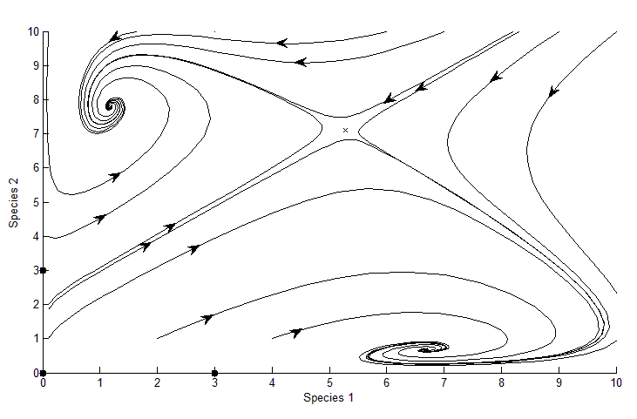
Two Stable Foci and One Saddle Equilibrium Point in System [B]
H-P
C
H-P

Slide 20
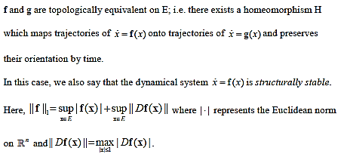
Structural Stability - Definition

Slide 21
Structural Stability – Intuitively
©2012 Rovio Entertainment Ltd.

Slide 22
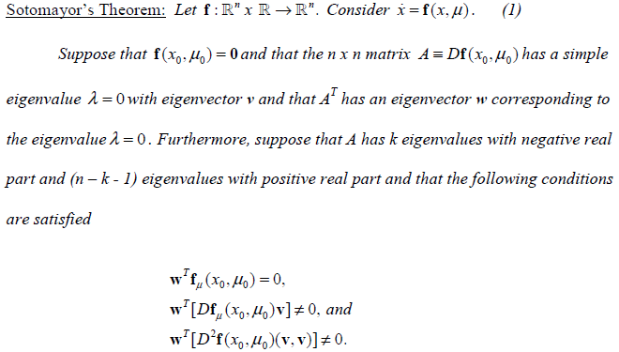

Slide 23
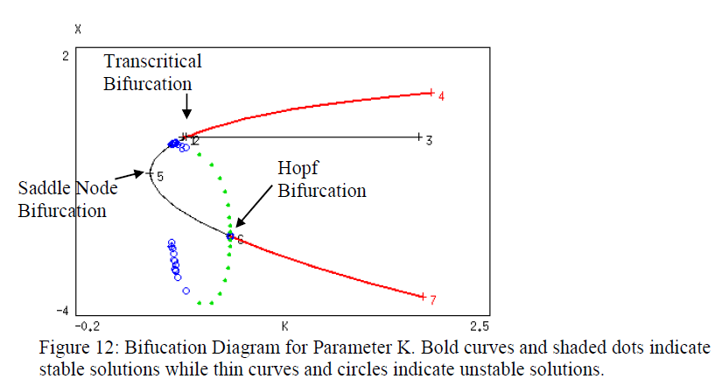
Bifurcations – Loss of Structural Stability

Slide 24
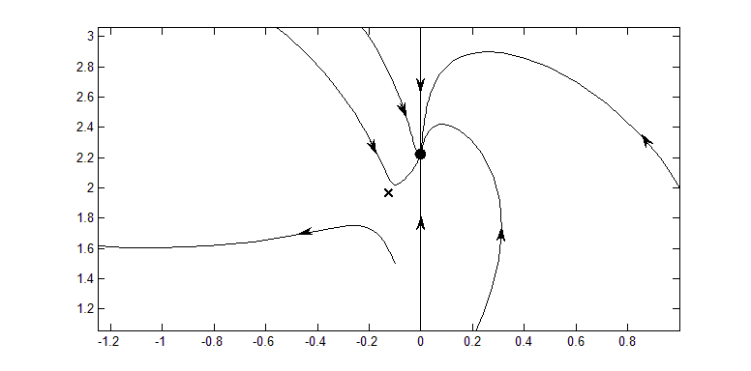
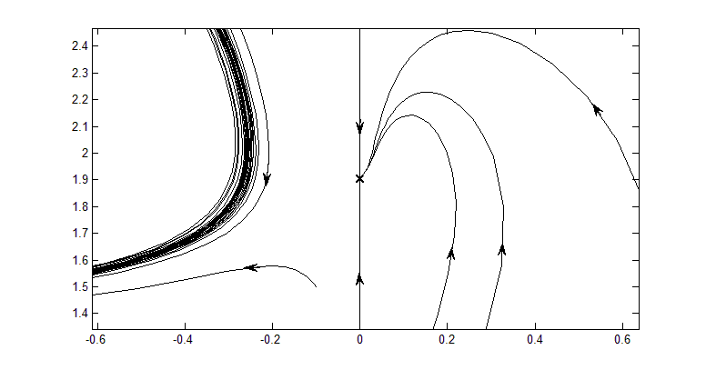
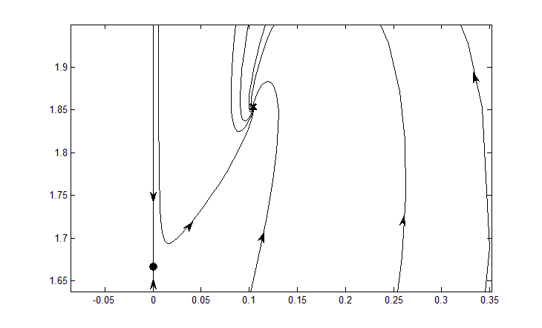
Transcritical Bifurcation at K₀ = 0.5246991
K=0.45
K=K₀
K=0.60

Slide 25
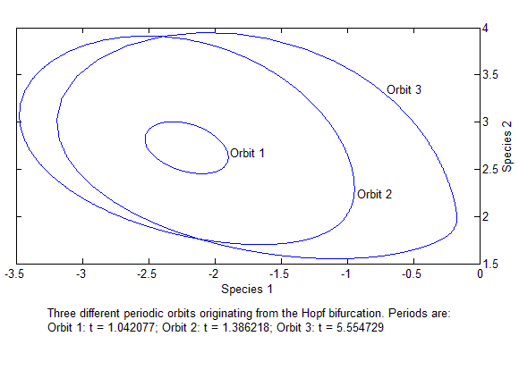
Hopf Bifurcation – Periodic Orbits
Three periodic orbits originating from the Hopf bifurcation.
Periods are: Orbit 1: t = 1.042077; Orbit 2: t = 1.386218; Orbit 3: t = 5.554729

Slide 26
Conclusion
Modeling variable interactions possible
Observed foci, center-type equilibria, and
3 types of bifurcations
Extended work of Hernandez (1998-2008) and
Zhang et al. (2007)
Future Research:
Non-linear α-functions
Harvesting functions
Extend dependence of α(x,y)
Extend models to 3 or 4 interacting species
α
(N₀, Y₀)
N

