Slide 1
Schur Factorization
Heath Gemar
11-10-12
Advisor: Dr. Rebaza

Slide 2
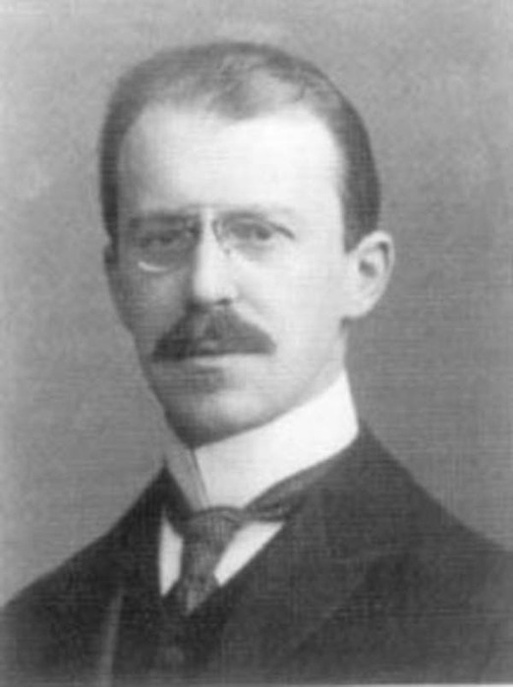
Overview
Definitions
Theorems
Proofs
Examples
Physical Applications

Slide 3
Definition 1
We say that a subspace S or R^{n} is invariant under A_{nxn}, or A-invariant if:
  x ϵ S ➔ Ax ϵ S,
  Or equivalently, AS is a subset of S.

Slide 4

Definition 2
An m x n matrix Q is called Orthogonal if
  Q^{T}Q=I
  Properties (m=n):
    $Q^{−1}=Q^{T}$
    The columns of Q are orthonormal
    The rows of Q are orthonormal
  Example:
    $\left[\begin{matrix}0 & \frac{1}{\sqrt{3}} \\ \begin{aligned}\frac{1}{\sqrt{2}} \\ \frac{1}{\sqrt{2}}\end{aligned} & \begin{aligned}\frac{1}{\sqrt{3}} \\ \frac{1}{−\sqrt{3}}\end{aligned}\end{matrix}\right]$

Slide 5
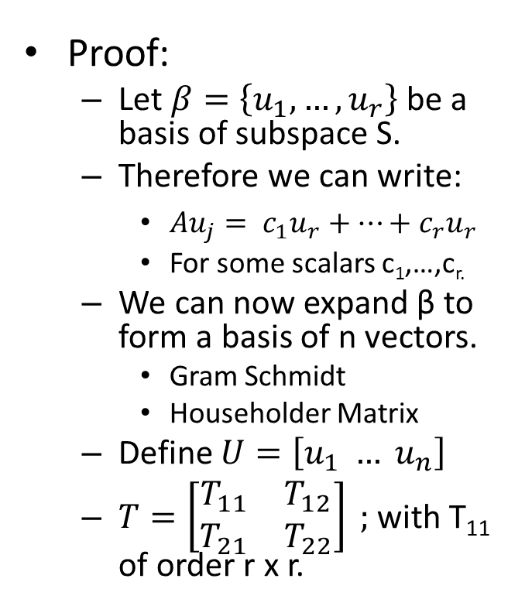

Theorem 1
Let S be invariant under A_{nxn}, with dim(S)=r. Then, there exists a nonsingular matrix U_{nxn} such that:
  $U^{−1}AU=T=\left[\begin{matrix}T_{11} & T_{12} \\ 0 & T_{22}\end{matrix}\right]$
  Where T₁₁ is square of order r.
Proof:
  Let $β=\left\{u_{1},…,\left.u_{r}\right\}\right.$ be a basis of subspace S.
  Therefore we can write:
    $Au_{j}= c_{1}u_{r}+…+c_{r}u_{r}$
    For some scalars c₁,…,c_{r.}
  We can now expand β to form a basis of n vectors.
    Gram Schmidt
    Householder Matrix
  Define $U=\left[u_{1} … \left.u_{n}\right]\right.$
  $T=\left[\begin{matrix}T_{11} & T_{12} \\ T_{21} & T_{22}\end{matrix}\right] ;$with T₁₁ of order r x r.

Slide 6

Proof of Theorem 1 Continued:
Expansion of U leads to it being orthogonal.
Therefore $U^{−1}=U^{T}$.
Define $X=$ $\left\{u_{2},…,\left.u_{n}\right\}\right.$ ➔ $U=\left[u_{1} \left.X\right]\right.$
$U^{−1}AU= \left[\begin{aligned}{u_{1}}_{}^{T} \\ X^{T}\end{aligned}\right]\left[Au_{1} A\left.X\right]\right.=\left[\begin{matrix}{u_{1}}^{T}Au_{1} & {u_{1}}^{T}AX \\ X^{T}Au_{1} & X^{T}AX\end{matrix}\right]$
Note: Au₁=λ₁u_{1,} where λ₁ is a constant.
➔ $U^{−1}AU=\left[\begin{matrix}λ_{1} & {u_{1}}^{T}AX \\ 0 & X^{T}AX\end{matrix}\right]$

Slide 7

Example
Let$A=\left[\begin{matrix}79 & \begin{matrix}−64 & −2\end{matrix} \\ \begin{aligned}8 \\ −20\end{aligned} & \begin{aligned} \begin{matrix}13 & 35\end{matrix} \\ \begin{matrix} 8 & 7\end{matrix}\end{aligned}\end{matrix}\right]$, let $u=\left[\begin{matrix}−0.9645 & 0.0219 & 0.2631\end{matrix}]\right.$^{T} span S. We define $U=\left[\begin{matrix}−0.9645 & \begin{matrix}1 & 0\end{matrix} \\ \begin{matrix}0.0219 \\ 0.2631\end{matrix} & \begin{matrix}\begin{matrix}1 & 1\end{matrix} \\ \begin{matrix}0 & 0\end{matrix}\end{matrix}\end{matrix}\right]$ to be the expanded orthogonal basis.
➔$U^{−1}AU=\left[\begin{matrix}81 & −45.6180 & 30.4120 \\ 0 & −29 & −34.6667 \\ 0 & 51 & 42\end{matrix}\right]$

Slide 8

Theorem 2: Real Schur Factorization
Let A_{nxn} be an arbitrary real matrix. Then, there exists an orthogonal matrix Q_{nxn}, and a block upper triangular matrix T such that:
$Q^{T}AQ=T=\left(\begin{matrix}T_{11} & ⋯ & T_{1m} \\ ⋮ & ⋱ & ⋮ \\ 0 & ⋯ & T_{mm}\end{matrix}\right)$
Where each diagonal block T_{ii} is either a 1x1 or 2x2 real matrix, the latter with a pair of complex conjugate eigenvalues. The diagonal blocks can be arranged in any prescribed order.

Slide 9

Proof of Theorem 2
From proof of Theorem 1:
  $B≔U^{T}AU=\left[\begin{matrix}b_{11} & B_{12} \\ 0 & B_{22}\end{matrix}\right]$
By Induction we know there exists a matrix W such that W^{T}B₂₂W is upper block triangular.
Define V=diag(1,W) and Q=UV
  ➔ $Q^{T}AQ=V^{T}U^{T}AUV=V^{T}BV=\left[\begin{matrix}λ & ∗ \\ 0 & W^{T}B_{22}W\end{matrix}\right]$
Continue to redefine the lower right block until all new eigenvalues are determined.
Variation for complex eigenvalues.

Slide 10

Example
Let $A=\left[\begin{matrix}−2 & 4 & \begin{matrix}0 & −1\end{matrix} \\ 8 & −1 & \begin{matrix} 0 & 4\end{matrix} \\ \begin{matrix}−2 \\ 7\end{matrix} & \begin{matrix}1 \\ 7\end{matrix} & \begin{matrix}\begin{matrix} 1 & 9\end{matrix} \\ \begin{matrix}−1 & −1\end{matrix}\end{matrix}\end{matrix}\right]$
  Eigenvalues: λ₁=6.1429, λ₂=-7.9078, λ_{3,4}=-0.6175 ± 1.7365i.
Schur Factorization gives:
  $Q^{T}AQ=T=\left[\begin{matrix}6.1429 & 2.3027 & \begin{matrix}7.1693 & −2.8451\end{matrix} \\ 0 & −0.6175 & \begin{matrix}−0.2731 & 0.9995\end{matrix} \\ \begin{matrix}0 \\ 0\end{matrix} & \begin{matrix}11.0418 \\ 0\end{matrix} & \begin{matrix}−0.6175 & 0.4232 \\ 0 & −7.9078\end{matrix}\end{matrix}\right]$
  $Q=\left[\begin{matrix}\begin{matrix}−0.1479 & −0.8513\end{matrix} & \begin{matrix}−0.0239 & 0.5029\end{matrix} \\ \begin{matrix}−0.4103 & −0.3567 \\ −0.7867 & 0.1490 \\ −0.4368 & 0.3548\end{matrix} & \begin{matrix}−0.3903 & −0.7430 \\ 0.5970 & 0.0493 \\ −0.7005 & 0.4389\end{matrix}\end{matrix}\right]$

Slide 11

Ordered Block Schur Factorization
Let A_{nxn} be an arbitrary real matrix. Then, there exists an orthogonal matrix Q_{nxn}, and a block upper triangular matrix T such that
  $Q^{T}AQ=T=\left[\begin{matrix}T_{11} & T_{12} \\ 0 & T_{22}\end{matrix}\right]$
Where T₁₁ is m x m and T₂₂ is (n – m) x (n – m), for some positive integer m. The diagonal blocks can be arranged in any prescribed order.

Slide 12

Example
$A=\left[\begin{matrix}3 & 5 & \begin{matrix}5 & −5 & 3\end{matrix} \\ −19 & −25 & \begin{matrix}−15 & 3 & −13\end{matrix} \\ \begin{matrix}41 \\ 9 \\ 14\end{matrix} & \begin{matrix}41 \\ 19 \\ 18\end{matrix} & \begin{matrix}19 & −9 & 13 \\ 5 & 3 & 17 \\ 10 & 2 & 8\end{matrix}\end{matrix}\right]$
$Q=\left[\begin{matrix}−0.5970 & −0.2784 & \begin{matrix}−0.6892 & 0.2441 & −0.1775\end{matrix} \\ 0.6692 & 0.0230 & \begin{matrix}−0.3656 & 0.1792 & −0.6211\end{matrix} \\ \begin{matrix}0.0753 \\ −0.1062 \\ −0.4228\end{matrix} & \begin{matrix}−0.1647 \\ −0.7421 \\ 0.5866\end{matrix} & \begin{matrix}−0.3272 & −0.9274 & 0 \\ 0.4886 & −0.0492 & −0.4437 \\ 0.2135 & −0.2138 & −0.6211\end{matrix}\end{matrix}\right]$

Slide 13

Continued…
$Q^{T}AQ=\left[\begin{matrix}−2 & −3.7790 & \begin{matrix}25.9596 & 8.9818 & 27.2895\end{matrix} \\ 0 & −6 & \begin{matrix}8.3761 & 1.0333 & 14.8848\end{matrix} \\ \begin{matrix}0 \\ 0 \\ 0\end{matrix} & \begin{matrix}0 \\ 0 \\ 0\end{matrix} & \begin{matrix}4 & −1.8420 & −11.5886 \\ 54.2893 & 4 & 43.3662 \\ 0 & 0 & 8\end{matrix}\end{matrix}\right]=\left[\begin{matrix}T_{11} & T_{12} \\ 0 & T_{22}\end{matrix}\right]$
$λ=8, −2, −6, 4±10i.$
Note: First two vectors of Q form an orthonormal basis of the vectors that span the negative real eigenvalues.

Slide 14

Physical Application
Huckel Theory
  Combination of Molecules
  Form new basis
    Schur Factorization (Hamiltonian)➔ New energy states
Connecting Orbits in Dynamical Systems
Remark:
  Factorization is also possible for matrix A(t) where $Q^{−1}\left(t\right)A\left(t\right)Q\left(t\right)=T(t)$ are as smooth as A(t).

Slide 15
References
Rebaza, Dr. Jorge. “A First Course in Applied Mathematics”.
Golub, Vanloan. “Matrix Computations”.
Stewart, G.W. “Matrix Algebra”.

Slide 16
THANK YOU
Dr. Rebaza
Dr. Reid
Missouri State University Mathematics Department

