Slide 1
Modeling the Effects of Curcumin Analogs on Colon Cancer Cells: A Mathematical Approach
Agers, Boyd, Eslinger, Warden
Faculty Advisor: Dr. Colin T. Barker
Drury University
November 9, 2024
Notes:
Write transitions in for every slide

Slide 2
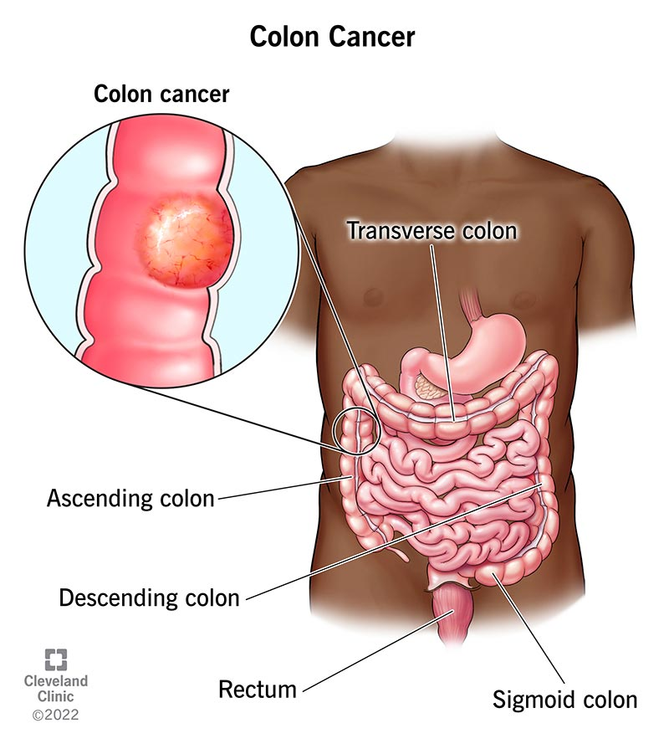
Introduction to Colon Cancer
A type of cancer that affects the large intestine (colon)
1.9 million new cases and 935,000 deaths worldwide each year, the third leading cause of cancer-related deaths
Increased risk with age, family history, lifestyle factors (diet, smoking, inactivity)
Regular screenings like colonoscopies can detect and remove polyps early
Notes:
A type of cancer that affects the large intestine (colon)
Begins when cells in the colon start to grow abnormally, forming benign polyps
Polyps can become cancerous over time through genetic mutations, can spread to other organs
1.9 million new cases and 935,000 deaths worldwide each year, the third leading cause of cancer-related deaths
Increased risk with age, family history, lifestyle factors (diet, smoking, inactivity)
Regular screenings like colonoscopies can detect and remove polyps early

Slide 3
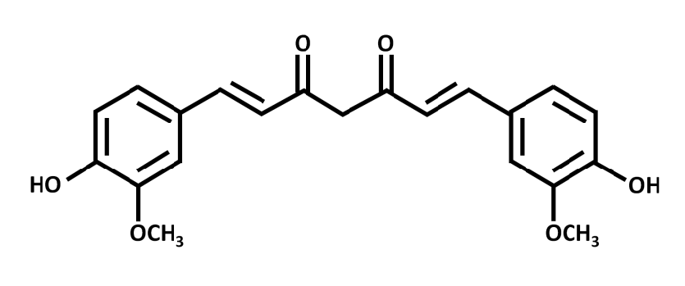
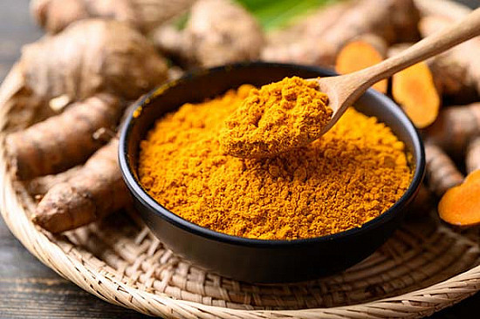
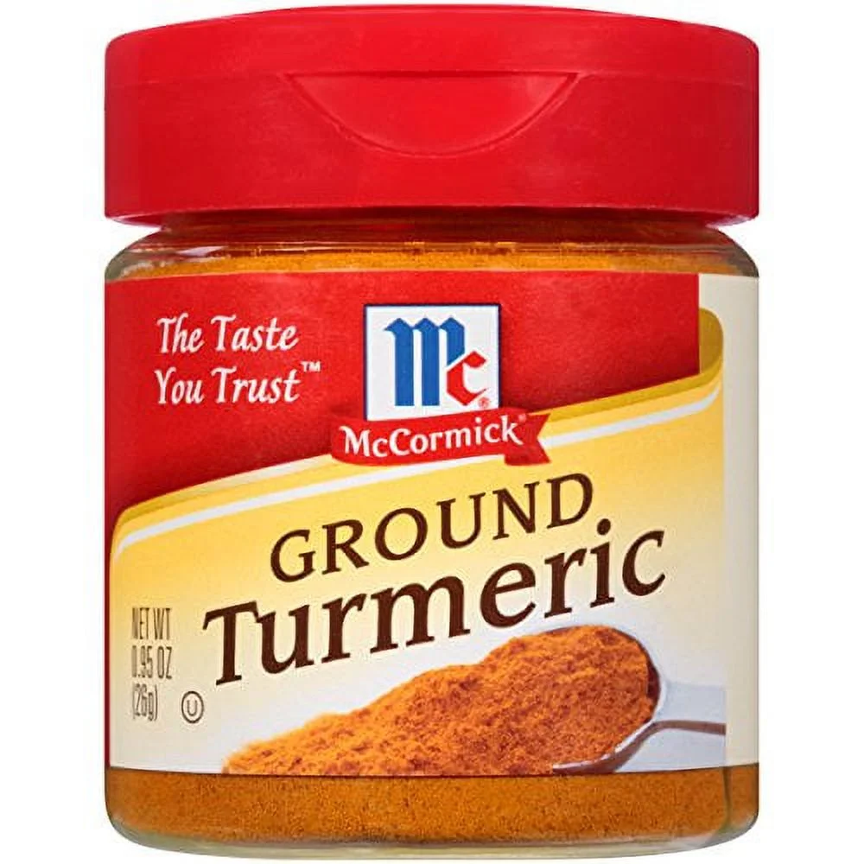
What is Curcumin?
Natural compound found in turmeric, commonly used as a spice
Known for its anti-inflammatory and potential anti-cancer properties
Low Bioavailability
Development of Analogs
Notes:
Potential Anti-Cancer Properties
Slows cancer cell growth and can induce cell death (apoptosis) in cancer cells
Inhibits pathways like EGFR that promote cell growth and division in cancer
Low Bioavailability
Curcumin has low bioavailability, meaning it’s poorly absorbed and quickly broken down in the body
Limits its effectiveness in reaching and acting on cancer cells
Development of Analogs
Modified forms of curcumin developed to improve absorption and stability in body
Aim to enhance its effectiveness as a potential treatment for colon cancer

Slide 4
How can Mathematical Modeling Assist Future Research?
Reduce the cost/labor of lab experiments that use active cancer cells
Simulating lab procedures using equations for predicted values mitigates human error
Notes:
Mathematical modeling in cancer drug research involves using ODE (ordinary diff eqs) and computational techniques to simulate biological processes related to cancer growth.
In lab settings there is a large factor of human error. For example: spills, contamination, or inaccurate data recording.
This approach allows researchers to predict how cancer cells respond to drugs under various conditions, optimize treatment strategies, and explore the underlying mechanisms of cancer progression.

Slide 5
Our Model - Modified SIR

Slide 7
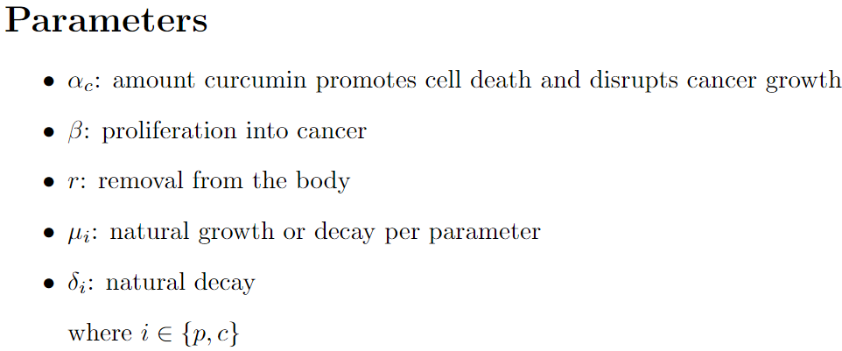
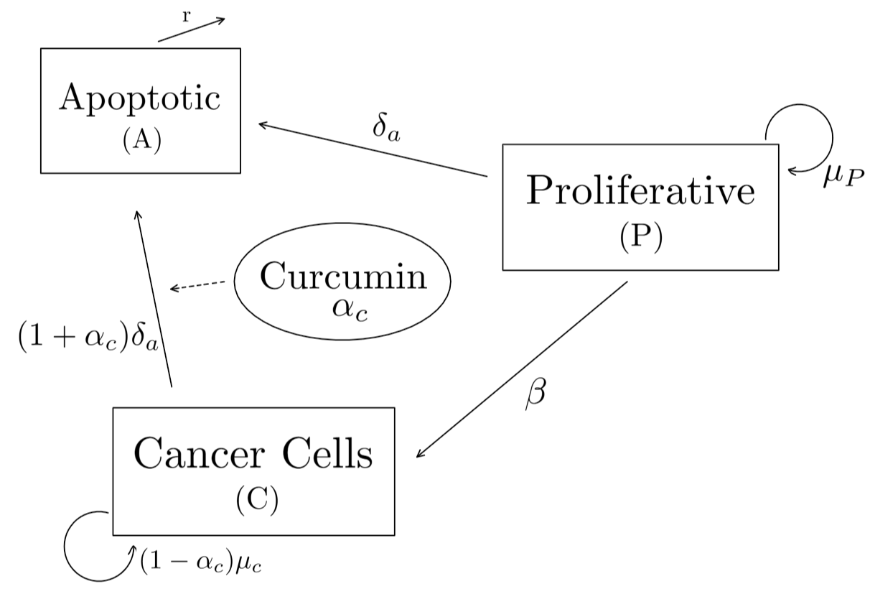
Notes:
Mu = mitosis, delta = death

Slide 8
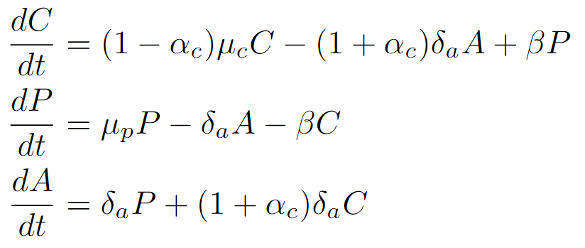
Notes:
Overleaf file: https://www.overleaf.com/4679886552vvkjgqctxznk#b3efbe

Slide 9
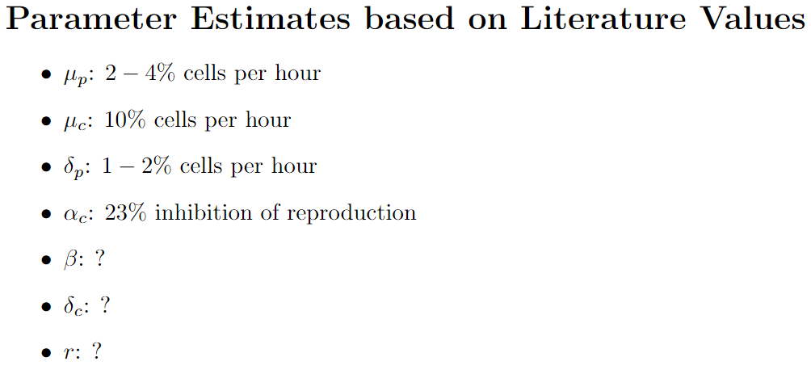
Notes:
Difficult to translate scientific values found from literature into functional mathematical model.

Slide 10
Graphing with Python
Using odeint( ) to solve the system of differential equations
lsoda method
Solving as a coupled system

Slide 11
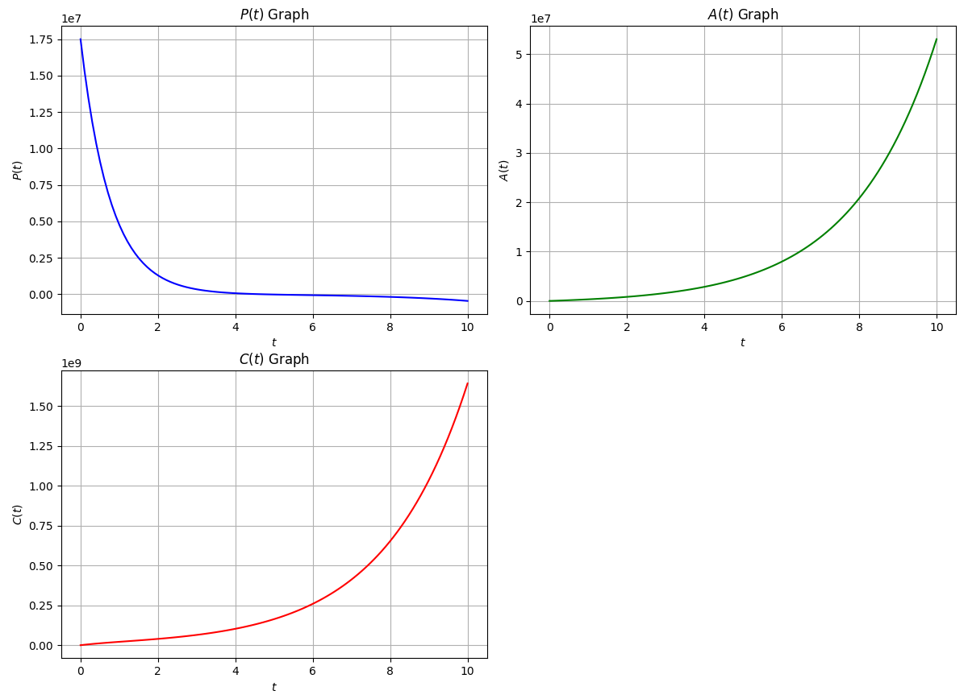
Python Output

Slide 12
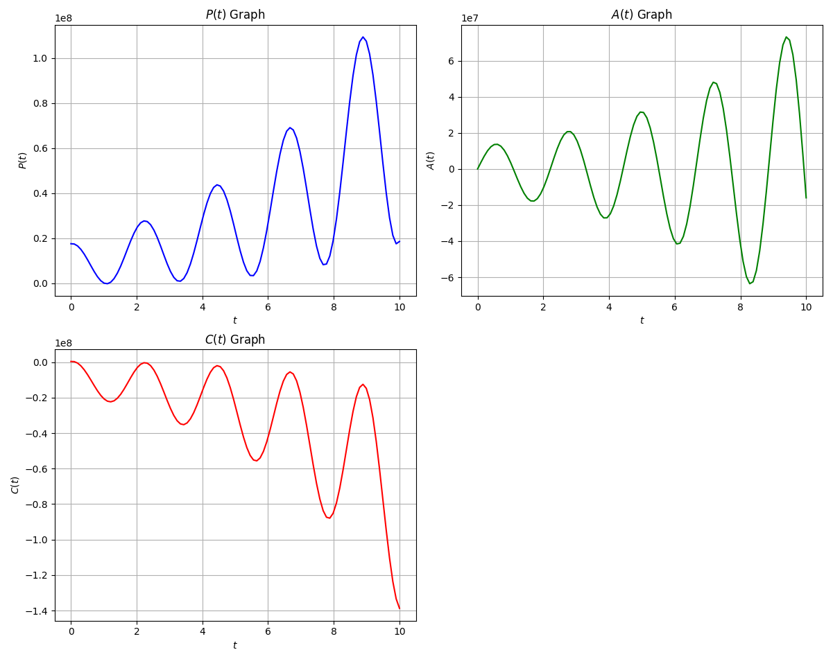
Python Output

Slide 13
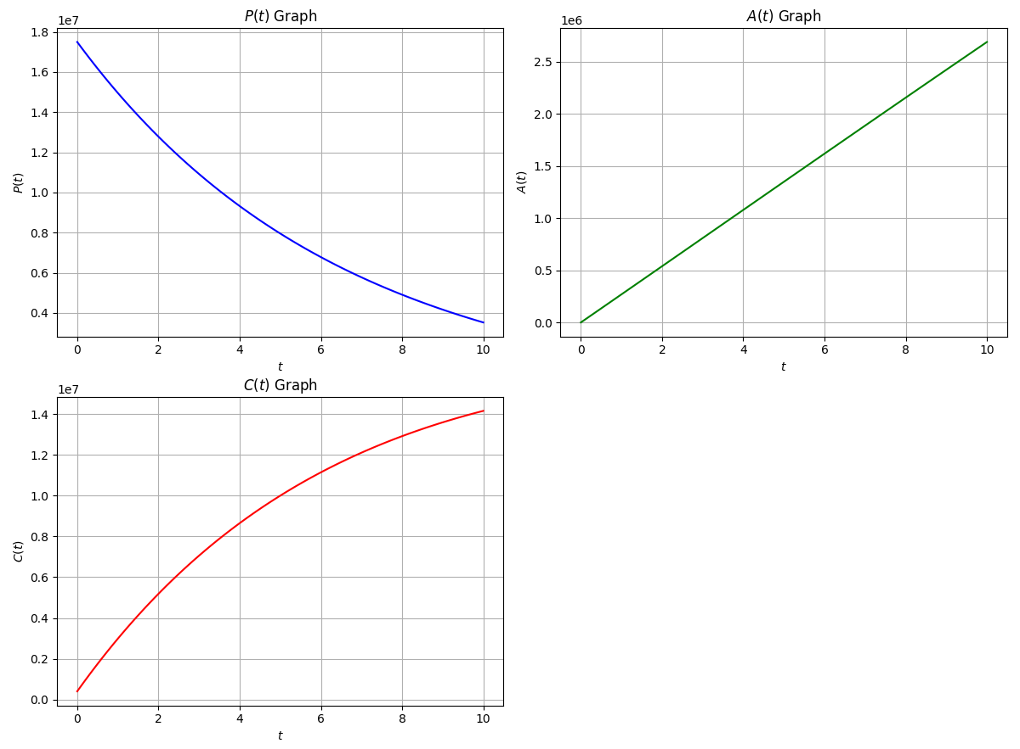
Python Output

Slide 14
Next Steps
Matching initial values and time to accurate scientific findings
Add data to current predictive models
Feasibility proof
Machine learning

Slide 15
Our Research Goal
Model cancer as accurately as possible

Slide 16
Citations
Baliyan S, Mukherjee R, Priyadarshini A, Vibhuti A, Gupta A, Pandey RP, Chang CM. Determination of Antioxidants by DPPH Radical Scavenging Activity and Quantitative Phytochemical Analysis of Ficus religiosa. Molecules. 2022 Feb 16;27(4):1326. doi: 10.3390/molecules27041326. PMID: 35209118; PMCID: PMC8878429.
Barker, C. T., et al. (n.d.). Modeling antiretroviral treatment to mitigate HIV in the brain: Impact of the blood-brain barrier.
Ghasemi M, Turnbull T, Sebastian S, Kempson I. The MTT Assay: Utility, Limitations, Pitfalls, and Interpretation in Bulk and Single-Cell Analysis. Int J Mol Sci. 2021 Nov 26;22(23):12827. doi: 10.3390/ijms222312827. PMID: 34884632; PMCID: PMC8657538.
“How to solve differential equations in Python.” (2021, September 13). YouTube. https://www.youtube.com/watch?v=MM3cBamj1Ms
National Cancer Institute. (n.d.). Cancer stat facts: Colorectal cancer. SEER. Retrieved August 30, 2024, from https://seer.cancer.gov/statfacts/html/colorect.htm l
Patel, L., Shukla, T., Huang, X., Ussery, D. W., & Wang, S. (2020). Machine learning methods in drug discovery. Molecules, 25(22), 5277. https://doi.org/10.3390/molecules25225277
“Runge-Kutta: Short explanation + Python script.” (2022, June 7). YouTube. https://www.youtube.com/watch?v=C_WsQeOjbV4
Thermo Fisher Scientific. (n.d.). Overview of ELISA. Retrieved August 30, 2024, from https://www.thermofisher.com/us/en/home/life-science/protein-biology/protein-biology-learning-center/protein-biology-resource-library/pierce-protein-methods/overview-elisa.html

Slide 17
Contact Us
Dr. Colin Barker
cbarker01@drury.edu
(417) 873-7235

