Slide 1
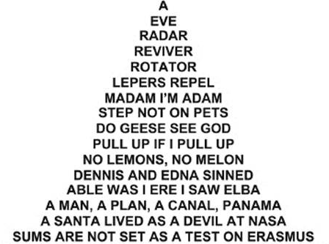
Super Basic Palindromes By Samuel Fulbright

Slide 2
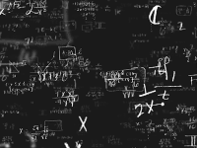
I: Introduction
Subject (Recreational Mathematics)
Palindromic Numbers
Bases and Base Conversion of Numbers
Formulas Using Summations
Coding in Python

Slide 3
I: Introduction
My Research
Exploring the relationship between palindromic numbers and the bases they are expressed in
In how many bases is an individual number expressed as a palindrome?
Mathematically define palindromic numbers with formula
Develop mathematical formulas to convert numbers from one base to another
Code these formulas into Python and record results with graphs

Slide 4
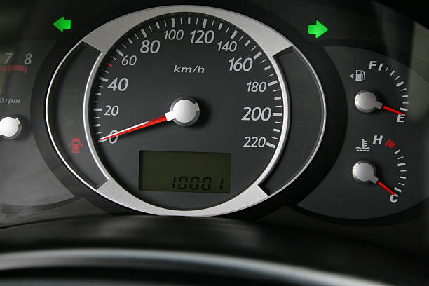
II: Beginning of Research and Inspiration
Drury KME Meeting: Problem is Introduced
10001 is a palindrome in base 2
Is also a palindrome when converted to base 10 (33).
Palindromicity of 2!
Questions:
In how many bases is 10001 a palindrome?
How many numbers are palindromes in (2,3,4,...,N) bases?

Slide 5
III: The Math- Concepts and Outlining
Outline:
Restrict numbers to natural numbers (positive integers)
Restrict range of bases to 2-10
Definition of Palindrome:
A number that is equal to itself when fully reversed.
Can be a single digit number.
Ex: 1221, 22, 111111, etc.

Slide 6
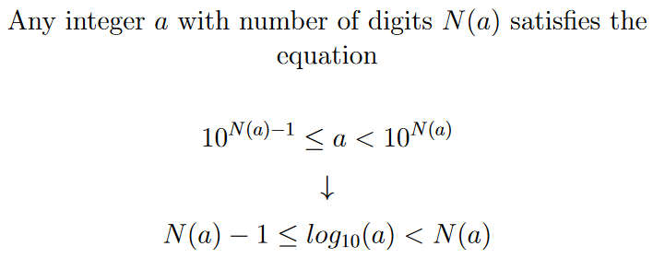
II: The Math- # of Digits Formula
Credits: Michael Albanese on StackExchange
Formula Box

Slide 7
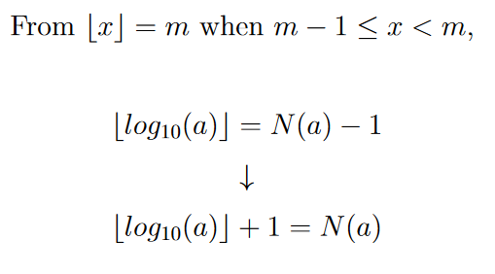
II: The Math- # of Digits Formula
Formula Box

Slide 8
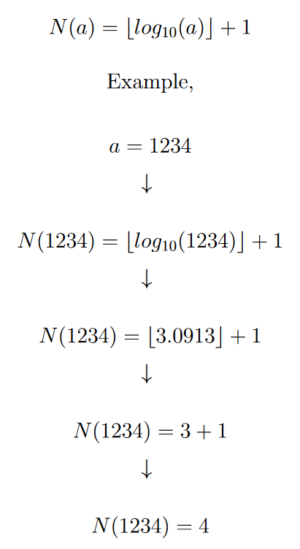

Slide 9
II: The Math- Inversion Formula
Credits: NeilRoy and pshmath0 on StackExchange
Formula Box

Slide 10
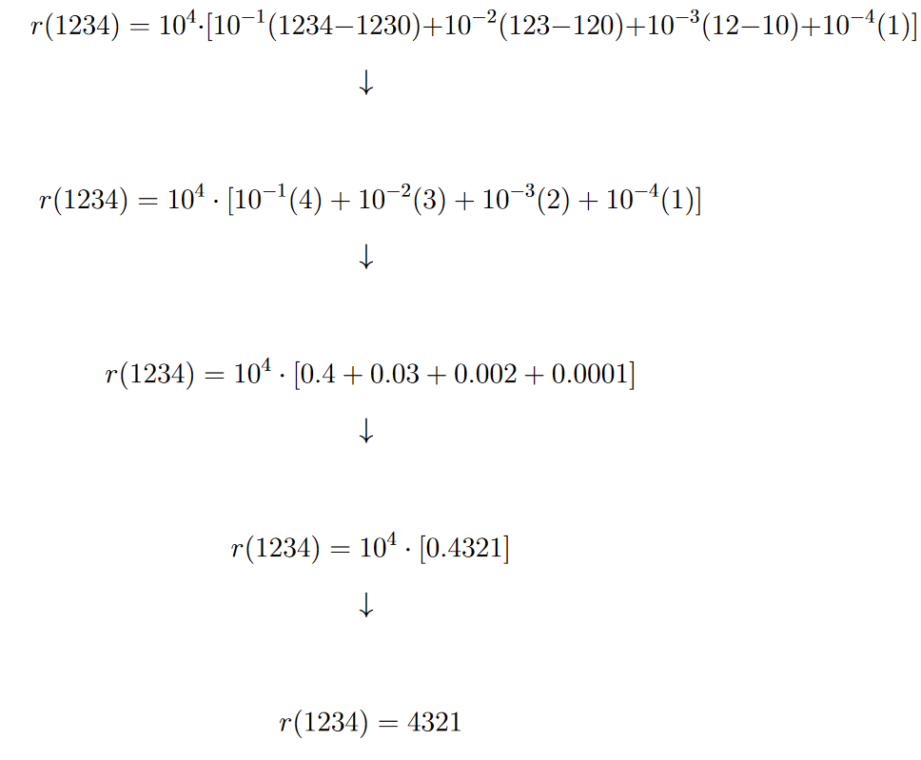
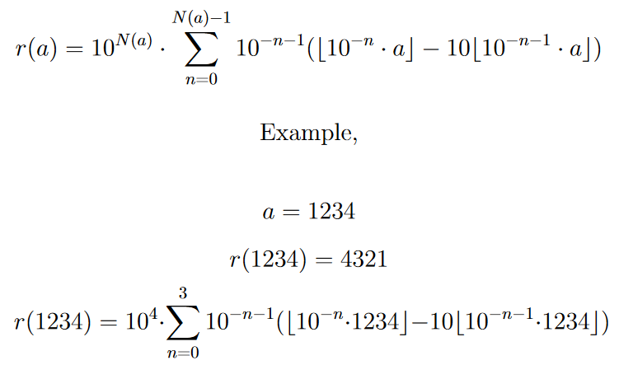
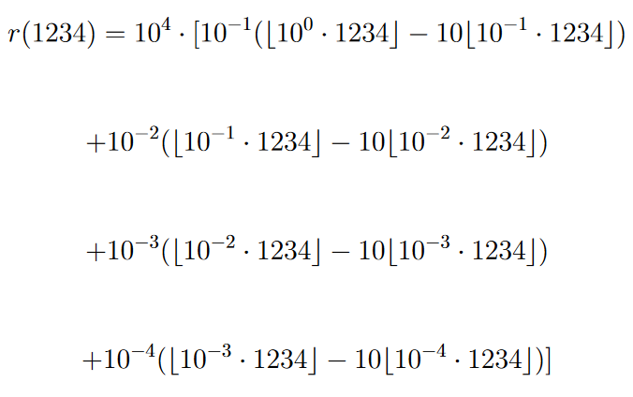
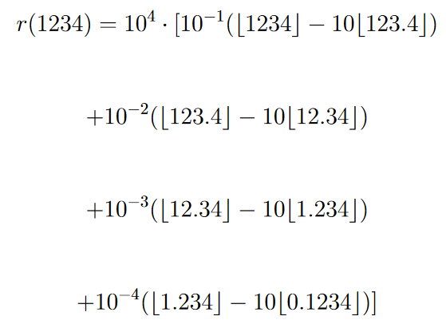
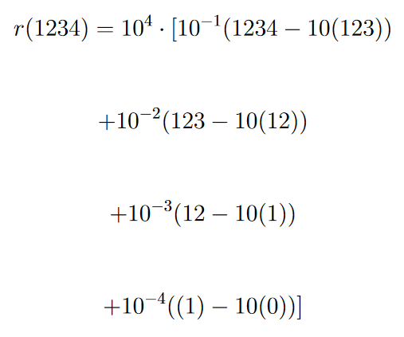

Slide 11
II: The Math- Digit Formula
Formula Box

Slide 12
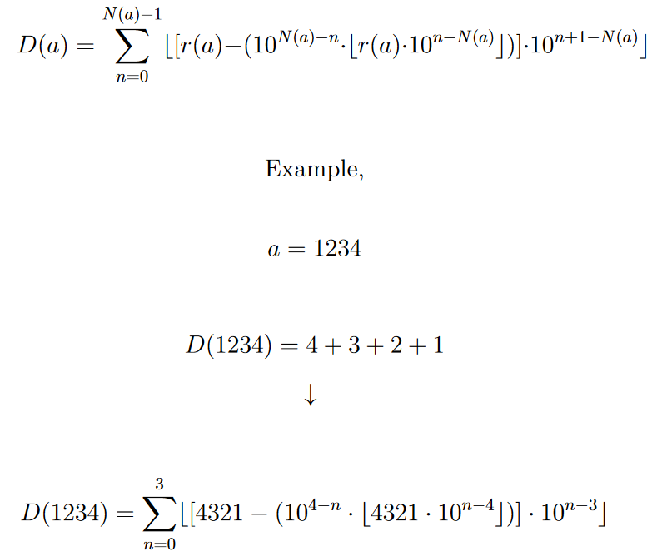
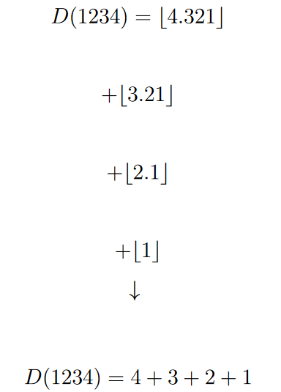
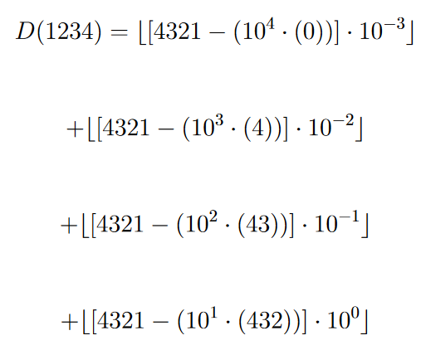
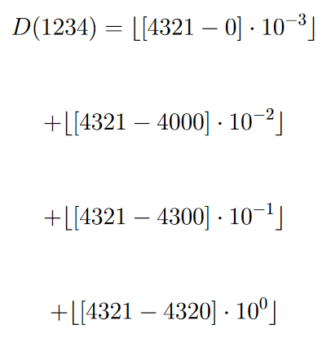
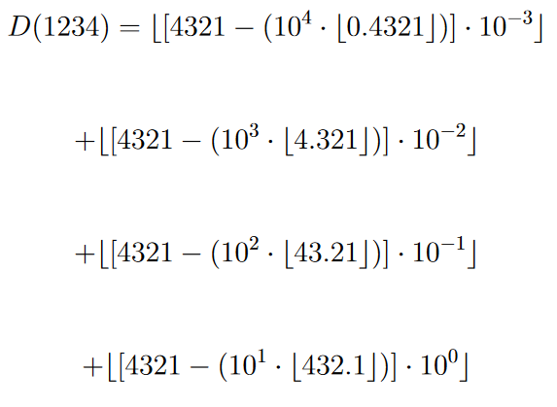
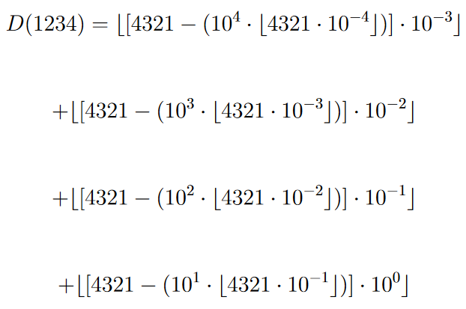
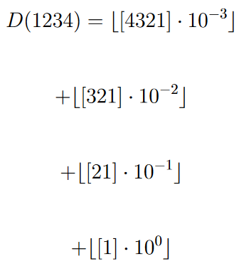

Slide 13
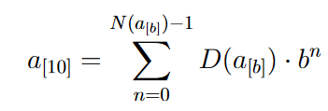
II: The Math- ‘b to 10’ Formula
Formula Box

Slide 14
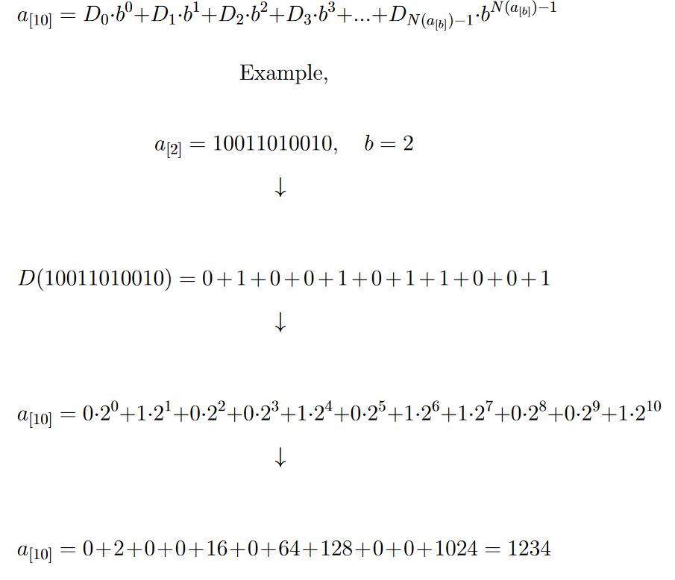

Slide 15
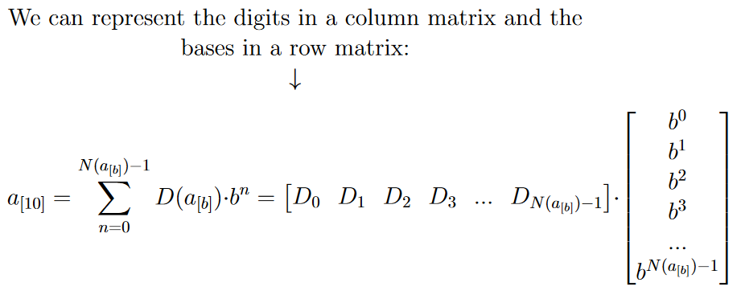
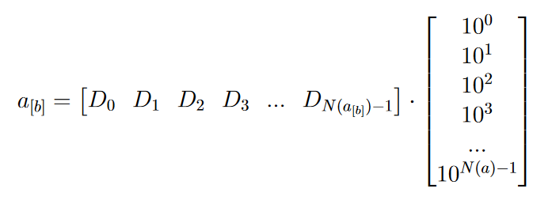
II: The Math- ‘10 to b’ Method 1
Formula Box

Slide 16
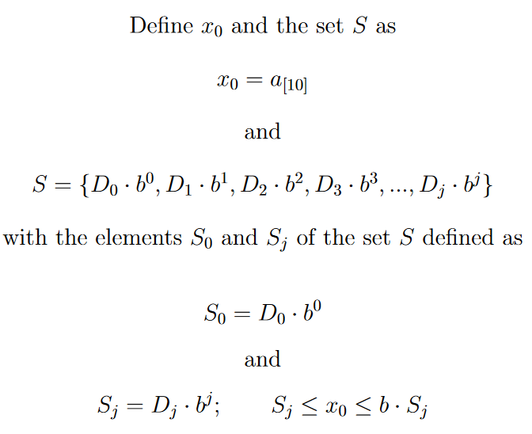
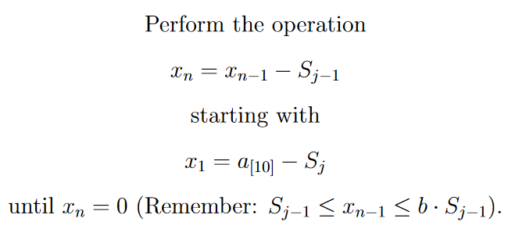
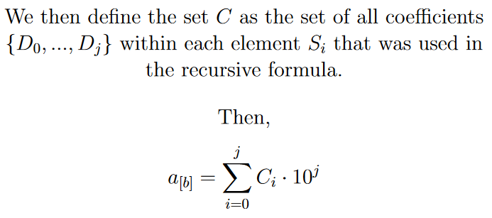
II: The Math- ‘10 to b’ Method 2
Formula Box

Slide 17
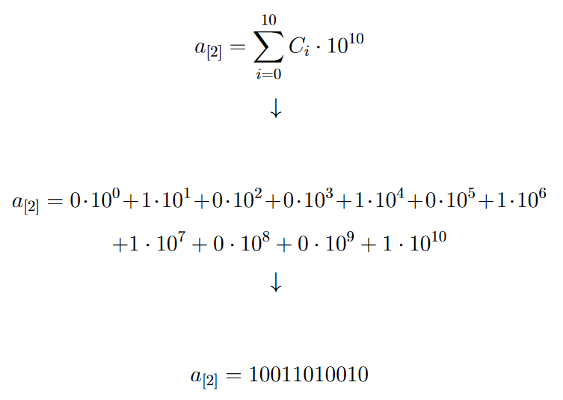
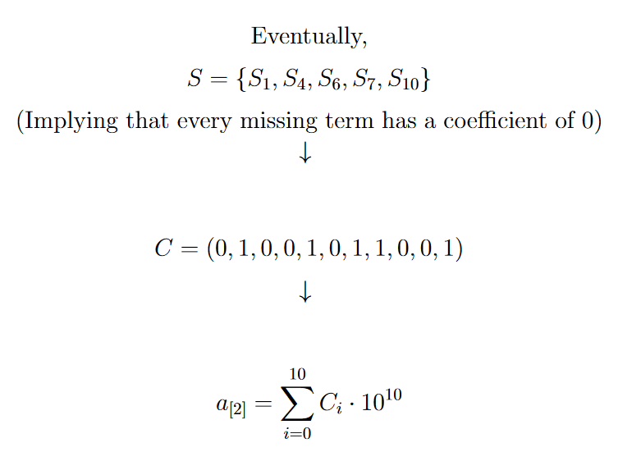
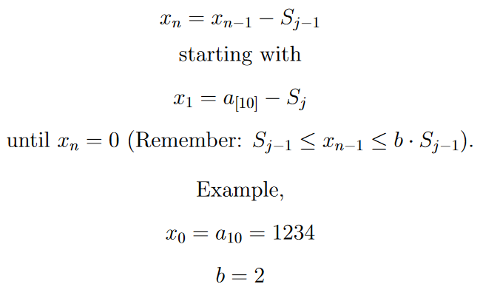
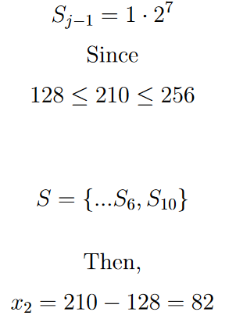
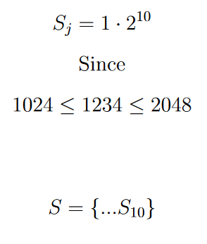

Slide 18
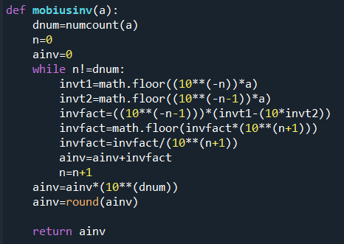
IV: The Coding- 1st Set of Formulas

Slide 19
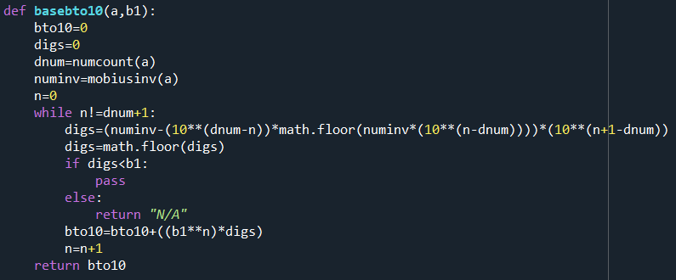
IV: The Coding- 2nd Set of Formulas

Slide 20
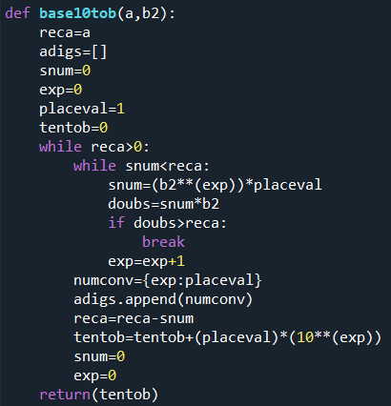
IV: The Coding- Last Formula!

Slide 21
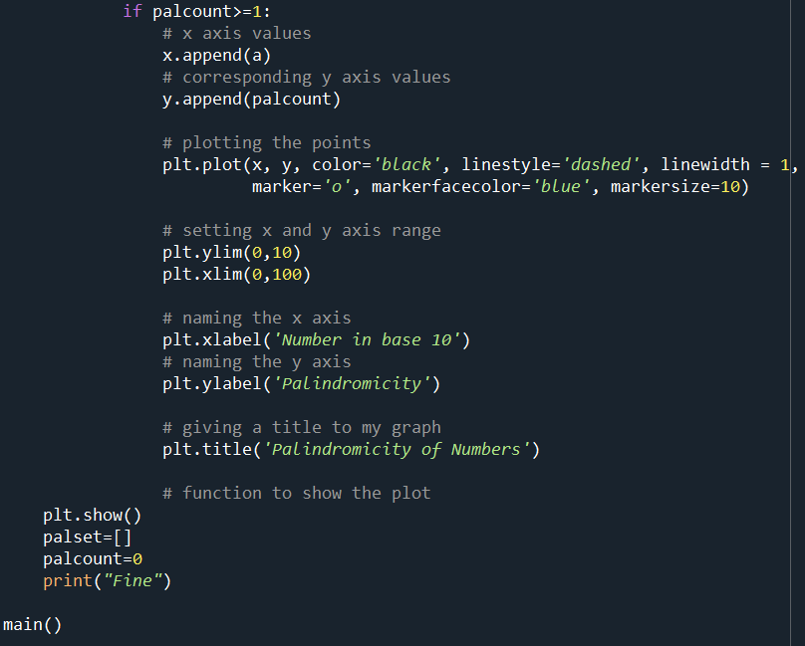
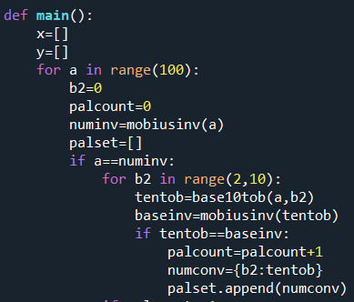
IV: The Coding- Graphing Palindromicity

Slide 22
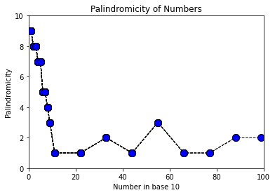
V: Results- Graphs
#: 55
Palindromicity: 3
B(4)= 313
B(6)= 131
B(10)= 55

Slide 23
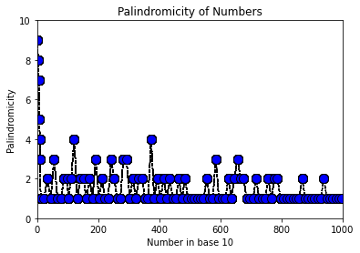
V: Results- Graphs
#: 656
Palindromicity: 3
B(3)= 220022
B(9)= 808
B(10)= 656

Slide 24
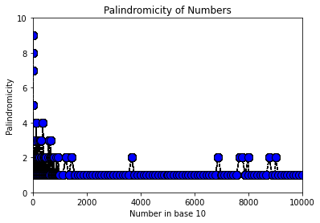
V: Results- Graphs
#: 3663
Palindromicity: 2
B(8)=7117
B(10)= 3663

Slide 25
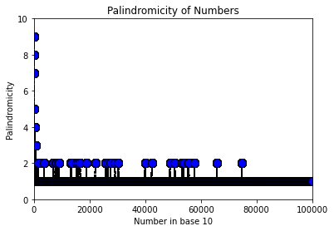
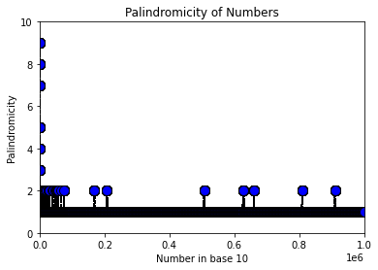
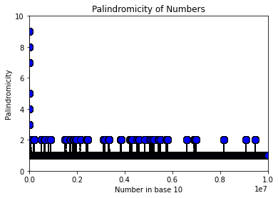
V: Results- Graphs
D(0,10²]:
D(0,10³]:
D(0,10⁴]:
D(0,10⁵]:
D(0,10⁶]:
D(0,10⁷]:

Slide 26
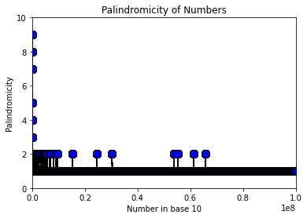
V: Results- Postulates
The math works!
Postulate I:
As you approach infinity, there will always be some number a which is palindromic in multiple bases
(Some number a will have palindromicity of 2 or greater)
Postulate II:
The palindromicity of any number a that is greater than 656 will always be less than or equal to 2.

Slide 27
V: Results- Future Goals
Optimize the Code
Expand Restrictions
More bases
Negative numbers
Decimals
Code Method I
Solution to Linear Equation is most likely faster than recursive formula

Slide 28
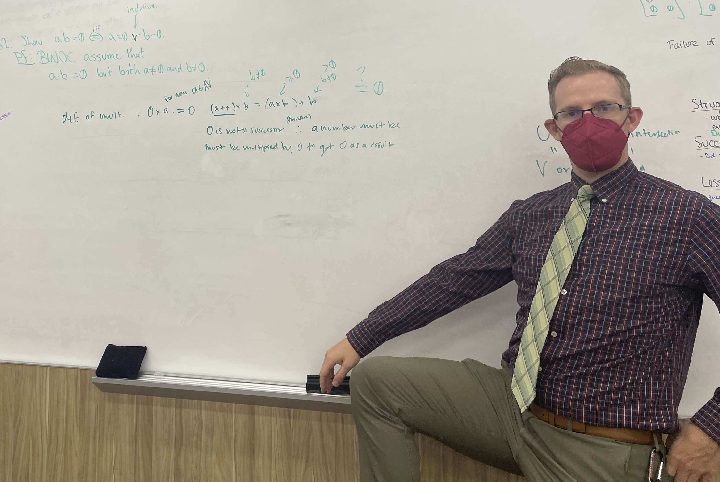
Acknowledgements
KME Members
Dr. Barker

