Slide 1
Using the Schmidt Decomposition Method to Determine Quantum Entanglement and its Use in Quantum Teleportation
Lane Boswell, Dr. Ying Cao Drury University, Springfield MO
Notes:
Remember to introduce myself.

Slide 2
Outline
Quantum Entanglement through Linear Algebra
Bra-Ket notation
Superposition
Entanglement
Schmidt Decomposition to determine Quantum Entanglement
Singular Value Decomposition
Density Matrix
Quantum Teleportation
Future work

Slide 3
Intro to QM Through Linear Algebra
Quantum particles exist in discrete states which can be represented by vectors
All attributes of a particle are determined by the state they are in (Energy level, position, momentum etc.)
For Quantum Information, the main attribute we care about is spin in the z direction
Notes:
A particle spinning –spin up and spin down states
Quantum states
Difference from classical state

Slide 4
Bra-Ket Notation
In Quantum Mechanics, our vectors are complex, and all lie in L² (-∞,∞) (Hilbert Space)
We use column vectors as a description of the particle, the elements of the vector are complex numbers
We transpose the column vectors and change the sign for our imaginary numbers to create a complex conjugate
This is known as Bra-Ket notation (or Dirac Notation)
When we multiply a Bra with a Ket we are performing the inner product, and the value we get is normalized to be 1, the other direction gives the outer product

Slide 5
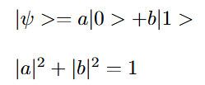
Explaining Superposition Using Linear Algebra
Superposition is a linear combination of states with attached probabilities
In terms of mathematics, it is simply a sum of vectors with attached probabilities
Before the particle is measured, it is in a sum of all possible states
When we measure the particle, it collapses to a single state
Notes:
A wave function that is a combination of base states with attached probabilities.

Slide 6
Qubits and Information Theory
In Quantum Information Theory the main aspect of a particle we focus on is its spin in the z direction
For particles such as electrons, they only have 2 spin states, spin up or spin down ½
This is convenient because of how it parallels a classical bit, which has two different possible values, 0 or 1
We define a quantum bit (qubit) as a quantum system with two possible states, thus we typically use the spin of an electron as our quantum system
The difference of a qubit is that there is a third possible state, which is a superposition of spin up and spin down
Notes:
A classical in a system that stores
A quantum bit: a system that can store a qubit (of information) and sometimes to refer to the mathematical set representing possible quantum states of such systems. In this chapter and elsewhere, we focus on the ideal physical system capable of storing one qubit of information and refer to it simply as the qubit, in accordance with the most common usage in the physics literature.

Slide 7
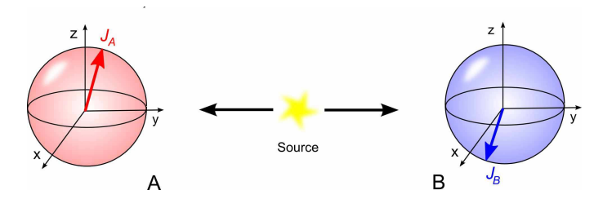
The EPR Paradox
Start with particle with zero spin
Decays into particles with spin
Both in superposition of spin up and spin down
Measure one and get spin up
Now the other must be spin down to conserve angular momentum

Slide 8
Multiple-qubit Systems and Entanglement
Analyzing systems with more than one qubit in them allows for exponentially stronger computation
Mathematically, a multiple qubit system is written as a tensor product between the single qubit systems
entanglement can arise between these qubits, which allows for novel applications
We must first determine whether two qubits are entangled

Slide 9
Determining Entanglement: The Schmidt Decomposition
Given an equation denoting a multi-qubit system
Change-of-basis on the multi-qubit system (2 possible methods)
Gives us a new form to denote the multi-qubit system
Determine the Schmidt number by counting the number of nonzero coefficients total in the summation
If the Schmidt number is greater than one, there is entanglement

Slide 10
Conceptual Explanation of The Schmidt Decomposition
The Schmidt decomposition analyzes a vector space that is a tensor product of two separate subspaces
The newly constructed equation dictates how many axis the two subspaces share
All subspaces will share at least one axis with each other
If more than one axis is shared, it means that the two subspaces are entangled with each other, since an output in one subspace will dictate the output in the other

Slide 11
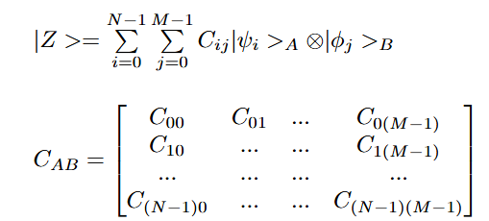
Method 1: Using Singular Value Decomposition
Given a multi-qubit system:
Construct a matrix of coefficients as follows:
From here we will use Singular Value Decomposition

Slide 12
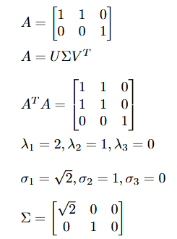
Singular Value Decomposition
Given a matrix A:
Wish to reconstruct as:
First multiply the transpose of A with A:
Next find the eigenvalues
Square root them and use the nonzero values to construct a diagonalized matrix
(Note that it must be the same dimensions as matrix A)

Slide 13
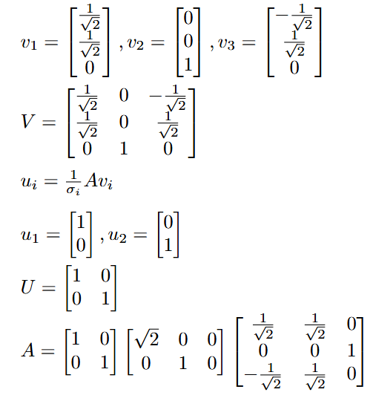
Singular Value Decomposition
Find the eigenvectors
Use the eigenvectors to construct V
Use the formula to find the u vectors
Use these vectors to construct U
From here we can reconstruct A as the following:

Slide 14
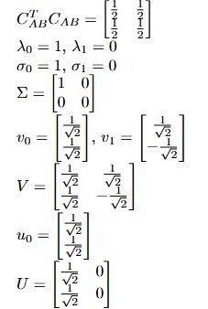
Method 1 Continued
Using Singular Value Decomposition on the matrix of coefficients we can find our σ_{k}'s, u_{k}'s and v_{k}'s:
The u_{k}'s will be the basis vectors for subsystem A and the v_{k}'s will be the basis vectors for subsystem B
From here we simply reconstruct our qubit equation using the following formula:

Slide 15
Summary of Method 1—phi 2 is separable

Slide 16
Method 2: Using the Density Matrix
Begin by constructing the density matrix for the multi-qubit system:
From here we want to construct the density matrices for subsystem A and subsystem B
We will do so by using the partial trace
Construct the subsystem density matrices as follows:

Slide 17
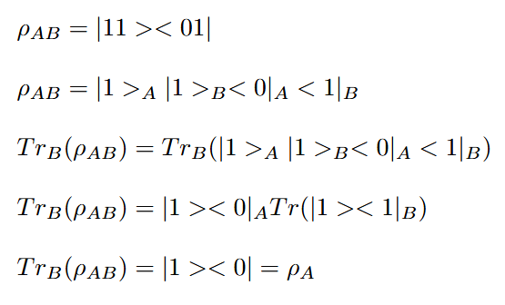
Partial Traces
Partial traces are ways of taking the trace of one subsystem, while leaving the other untouched
Unlike a standard trace, that produces a scalar, a partial trace produces a matrix
In the example, we start by clarifying the two subsystems:
Now taking the trace of subsystem B, we start by removing subsystem A from the trace:
Now it is a standard trace, which gives us our final answer:

Slide 18
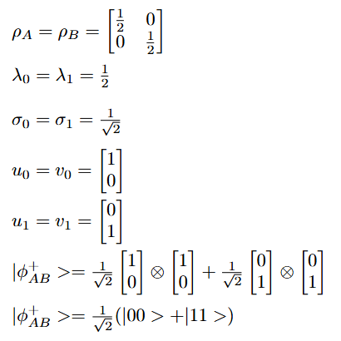
Method 2 Continued
From here we find the eigenvalues of each reduced density matrix (they will share eigenvalues):
Next find each reduced density matrix's eigenvectors (these may differ):
Square root the eigenvalues to find our σ_{k}'s:
The eigenvectors of density matrix A will be our u_{k}'s, the eigenvectors of density matrix B will be our v_{k}'s
Reconstruct the qubit equation as we did before:

Slide 19
Summary of Method 2—phi + is entangled

Slide 20
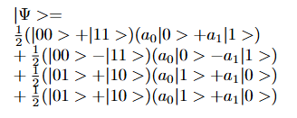
Application: Quantum Teleportation
Attempting to teleport the state of a qubit to different qubit, using entanglement
Start with a two-qubit entangled system, one qubit in lab A and one in lab B:
Receive an unknown qubit in lab A, wish to teleport its state to lab B
Create a three-qubit system
Using some algebraic rearrangement, we rewrite our equation as :

Slide 21
Quantum Teleportation Continued
In a superposition between 4 possible states:
Measure the two qubits in lab A using a bell measurement:
By finding which of the 4 possible states lab A's qubits is in, we now know what state lab B's qubit is in
Send 2 classical bits of information to lab B, telling it what lab A's result was
To reconstruct stray qubit, apply one of four Paulie Matrices to the lab B qubit:

Slide 22
Future work
Investigate the connection between the two Schmidt Decomposition methods
Determine correlation between reduced density matrices and maximal entanglement

Slide 23
Works Cited
Bradley, T. D. (2020). At the interface of algebra and statistics (Doctoral dissertation, City University of New York).
Cavalcanti, E. G., Drummond, P. D., Bachor, H. A., & Reid, M. D. (2009). Spin entanglement, decoherence and Bohm’s EPR paradox. Optics Express, 17(21), 18693-18702.
Griffiths, D. J., & Schroeter, D. F. (2018). Introduction to quantum mechanics. Cambridge university press.
Jaeger, G. (2007). Quantum information (pp. 81-89). Springer New York.

Slide 24
Thank you!
lboswell@drury.edu

