Slide 1
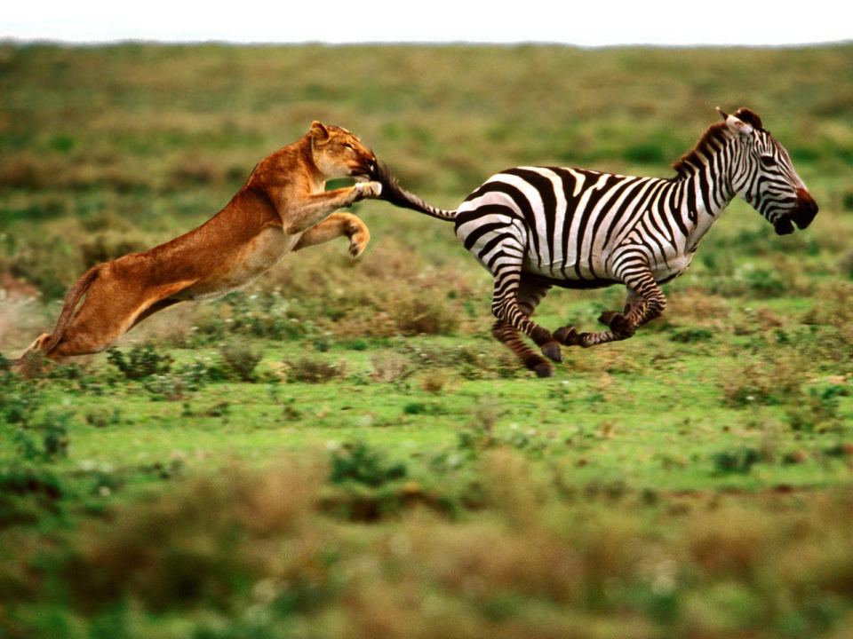
Dynamic Behaviors of a Harvesting Leslie-Gower Predator-Prey Model
Josh Durham
Jacob Swett

Slide 2
The Article
Dynamic Behaviors of a Harvesting Leslie-Gower Predator-Prey Model
Na Zhang,¹ Fengde Chen,¹ Qianqian Su,¹ and Ting Wu²
¹ College of Mathematics and Computer Science, Fuzhou University, Fuzhou 350002, Fujian, China
² Department of Mathematics and Physics, Minjiang College, Fuzhou 350108, Fujian, China
Published in Discrete Dynamics in Nature and Society
Received 24 October 2010; Accepted 8 February 2011
Academic Editor: Prasanta K. Panigrahi

Slide 3
Outline
Introduction
Stability Property of Positive Equilibrium
The Influence of Harvesting
Bionomic Equilibrium
Optimal Harvesting Policy
Numerical Example
Conclusions
Questions

Slide 4
Predatory Prey Model
$\frac{dH}{dt}=\left(r_{1}− a_{1}P− b_{1}H\right)H$
$\frac{dP}{dt}=\left(r_{2}− a_{2}\frac{P}{H}\right)P$
$H$ – density of prey species
$P$ – density or predator species
$r_{1,2}$- intrinsic growth rate for prey and predator, respectively
$a_{1}$ - catch rate
$b_{1}$ - competition rate
$a_{2}$ - prey conversion rate
$r_{1}/$ $b_{1}$ is the carrying capacity of the prey
$r_{2}H/a_{1}$ is the prey-dependent carrying capacity of the predator

Slide 5
Model with Harvesting
$\frac{dH}{dt}=\left(r_{1}− a_{1}P− b_{1}H\right)H− c_{1}H$
$\frac{dP}{dt}=\left(r_{2}− a_{2}\frac{P}{H}\right)P− c_{2}P$
$c_{1}$ - constant effort spent by harvesting agency on the prey
$c_{2}$ - constant effort spent by harvesting agency on the predator
Assume: $0< c_{i} < r_{i}, i=1,2$

Slide 6
Why Study a Harvesting Model?
The harvesting of biological resources commonly occurs in:
Fisheries
Forestry
Wildlife management
Allows for predictions given various assumptions
Important for optimization

Slide 7
Stability Property of Positive Equilibrium
Given that the harvesting remains strictly less than the intrinsic growth rate, the system under study has a unique positive equilibrium
Satisfies the following equalities
$r_{1 }−{c_{1 }−b_{1 }H}_{1∗}−a_{1 }P_{1∗}=0$, $r_{2 }−c_{2 }=\frac{P_{1∗}}{H_{1∗}}$

Slide 8
What does this mean?
It means that the positive equilibrium of the system under study is locally asymptotically stable
Stability is the same as what we have discussed in class
The proof of this is very similar to examples that we have done in class.
First, find the Jacobian
$$\left(\begin{matrix}r_{1}−c_{1}a_{1}P−2b_{1}H & −a_{1}H \\ a_{2}\frac{P^{2}}{H^{2}} & r_{2}−c_{2}−2a_{2}\frac{P}{H}\end{matrix}\right)$$

Slide 9
Proof Continued
Then we find the characteristic equation
Given the above information, we can see that the unique positive equilibrium of the system is stable

Slide 10
Global Stability
The positive equilibrium is globally stable
The proof of this fact is beyond the scope of this course
Instead, there will be a brief summary of major points
Equilibrium dependent only on coefficients of system
Lyapunov Function
Lyapunov’s asymptotic stability theorem

Slide 11
Influence of Harvesting
Case 1: Harvesting only prey species
Case 2: Harvesting only predator species

Slide 12
Case 3: Harvesting predator and prey together
Difficult to give a detailed analysis of all possible cases so the focus will be on answering
Whether or not it is possible to choose harvesting parameters such that the harvesting of predator and prey will not cause a change in density of the prey species over time
If it is possible, what will the dynamic behaviors of the predator species be?
We find that:
allows the first question to be answered with, yes
We also find that by substituting the above equality into the predator equation, it will lead to a decrease in the predator species

Slide 13
Bionomic Equilibrium
Biological equilibrium + Economic equilibrium =Bionomic equilibrium
Biological equilibrium:
$\frac{dP}{dt}=$ $\frac{dH}{dt}=0$
Economic equilibrium:
TR = TC
TR is the total revenue obtained by selling the harvested predators and prey
TC is the total cost for the effort of harvesting both predators and prey

Slide 14
Bionomic Equilibrium (Cont.)
We will define four new variables:
p₁ is the price per unit biomass of the prey H
p₂ is the price per unit biomass of the predator P
q₁ is the fishing cost per unit effort of the prey H
q₂ is the fishing cost per unit effort of the predator P
The revenue from harvesting can written as:
$N=TR−TC=\left(p_{1}H− q_{1}\right)c_{1}+\left(p_{2}P−q_{2}\right)c_{2}= N_{1}+ N_{2}$
Where: $TR= p_{1}Hc_{1} + p_{2}Pc_{2}$ and $TC= q_{1}c_{1}+ q_{2}c_{2}$
And: $N_{1}= \left(p_{1}H− q_{1}\right)c_{1}$ and $N_{2}= \left(p_{2}P−q_{2}\right)c_{2}$

Slide 15
Bionomic Equilibrium (Cont.)
The revenue from harvesting equation and the predator and prey equations must all be considered together:
$N=TR−TC=\left(p_{1}H− q_{1}\right)c_{1}+\left(p_{2}P−q_{2}\right)c_{2}=0$
$\frac{dH}{dt}=\left(r_{1}− a_{1}P− b_{1}H\right)H− c_{1}H$
$\frac{dP}{dt}=\left(r_{2}− a_{2}\frac{P}{H}\right)P− c_{2}P$
Price per unit biomass (p_{1,2}) and the fishing cost per unit effort (q_{1,2}) are assumed to be constant
Since the total revenue (TR) and total cost (TC) are not determined, four cases will be considered to determine bionomic equilibrium

Slide 16
Case I
$\frac{q_{1}}{p_{1}}>H$
That is: $p_{1}H− q_{1} <0$
In other words the revenue ($p_{1}H$) is less than the cost ($q_{1}$) for harvesting prey and it will be stopped (i.e. c₁ = 0)
Thus, $N=TR−TC=\left(p_{2}P−q_{2}\right)c_{2}=0$
Predator harvesting will continue as long as $p_{2}P− q_{2} <0$
To determine equilibrium:
Solve for P
Substitute it into the predator equation
Substitute the predator equation and P into the prey equation
Simplify
Thus, if r₁ > a₂(q₂/p₂) and r₂ > (a₂b₁q₂/r₁q₂) both hold, then bionomic equilibrium is obtained.

Slide 17
Case II
$\frac{q_{2}}{p_{2}}>P$
That is: $p_{2}P− q_{2} <0$
In other words the revenue ($p_{2}P$) is less than the cost ($q_{2}$) for harvesting predators and it will be stopped (i.e. c₂ = 0)
Thus, $N=TR−TC=\left(p_{1}H−q_{1}\right)c_{1}=0$
Prey harvesting will continue as long as $p_{1}H− q_{1} <0$
Example:
$H=\frac{q_{1}}{p_{1}}$
Sub H into predator equation , $\frac{dP}{dt}=\left(r_{2}− a_{2}\frac{P}{H}\right)P− c_{2}P$
Yields: $P= \frac{r_{2}q_{1}}{a_{2}p_{1}}$
Substituting H and P into the prey equation, $\frac{dH}{dt}=\left(r_{1}− a_{1}P− b_{1}H\right)H− c_{1}H$
Yields: $c_{1}= r_{1}−a_{1}P−b_{1}H=r_{1}−\frac{(a_{1}r_{2}−a_{2}b_{1})q_{1}}{a_{2}p_{1}}$
Thus, if r₁ > ((a₁r₂ – a₂b₁)q₁/a₂p₁) holds then bionomic equilibrium is obtained for this case.

Slide 18
Case III
$\frac{q_{1}}{p_{1}}>H$ and $\frac{q_{2}}{p_{2}}>P$
That is to say, the total costs exceeds the revenue for both predators and prey
No profit
Clearly c₁ = c₂ = 0
No bionomic equilibrium

Slide 19
Case IV
$\frac{q_{1}}{p_{1}}<H$ and $\frac{q_{2}}{p_{2}}<P$
That is: $p_{1}H− q_{1} >0$ and $p_{2}P− q_{2} >0$
Solve as before
Thus if $r_{1}> \frac{(a_{1}p_{2}q_{1}− b_{1}p_{1}q_{2})}{p_{1}p_{2}}$ and $r_{2} > \frac{a_{2}p_{1}q_{2}}{p_{2}q_{1}}$ hold then bionomic equilibrium is obtained.
It becomes obvious that bionomic equilibrium may occur if the intrinsic growth rates of the predators and prey exceed the values calculated

Slide 20
Optimal Harvesting Policy
To determine an optimal harvesting policy, a continuous time-stream of revenue function, J, is maximized:
-δ is the instantaneous annual rate of discount
c₁(t) and c₂(t) are the control variables
The assumption: $0< c_{i} < r_{i}, i=1,2$; still holds
Pontryagin's Maximum Principle is invoked to maximize the equation

Slide 21
Pontryagin's Maximum Principle
A method for the computation of optimal controls
The Maximum Principle can be thought of as a far reaching generalization of the classical subject of the calculus of variations

Slide 22
Results and Implications
Applying Pontryagin's Maximum Principle to the revenue function J, shows that optimal equilibrium effort levels (c₁ and c₂) are obtained when:
Recall:
$r_{1,2}$- intrinsic growth rate for prey and predator, respectively
$a_{1}$ - catch rate
$b_{1}$ - competition rate
$a_{2}$ - prey conversion rate

Slide 23
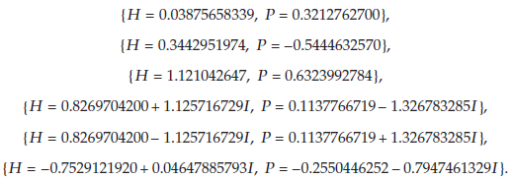
Numerical Example
Using the following values as inputs into the optimized equation:
Gives:
Solving with Maple, the authors obtained:

Slide 24
Numerical Example (Cont.)
From the previous results only one results meets the following conditions:
Namely:
These values can then be entered into the predator-prey harvesting equation

Slide 25
Numerical Example (Cont.)
Substituting the values for H and P into the below equations:
And rearranging to solve for c₁ and c₂, gives:

Slide 26
Conclusions
Introduced a harvesting Leslie-Gower predator-prey model
The system discussed was globally stable
Provided an analysis of some effects of different harvesting policies
Considered economic profit of harvesting
Results show that optimal harvesting policies may exist
Demonstrate that the optimal harvesting policy is attainable

Slide 27
Questions?

