Slide 1
Machine Learning for the Game of Hex
Justin Kroh
Mentor: Dr. Bob Robertson Drury University Fall 2024

Slide 2
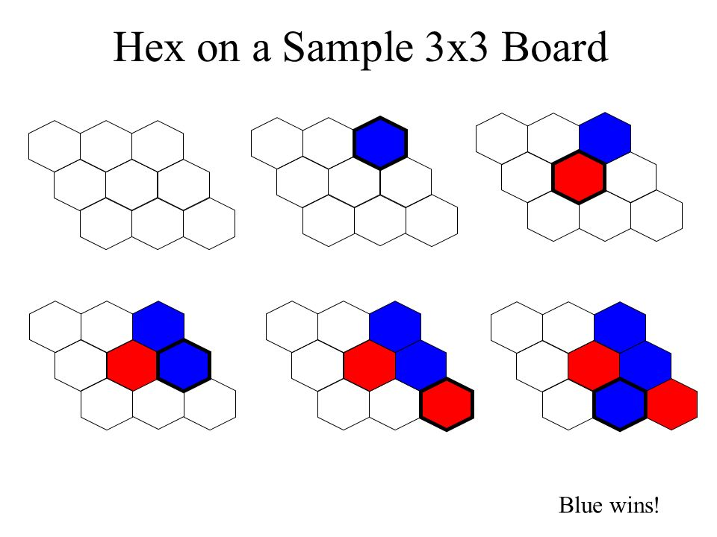
The Game
Game board is a grid made of hexagons.
There are two players (Blue vs. Red in our case).
Players take turns placing pieces on the board.
If red can connect the left and right sides of the board, red wins!
If blue can connect the top and bottom sides of the board, blue wins!

Slide 3
Two Important Theorems
The Hex Theorem:
No matter how the board is filled with Red and Blue, there will always be one and only one player who has connected their respective sides.
Last year, we managed to develop our own proof of the Hex Theorem.
Zermelo’s Theorem:
If the game cannot end in a draw, then Zermelo’s theorem implies one of the two players must have a winning strategy.
Given these, we know one player has a winning strategy for Hex.

Slide 4
Who Has The Winning Strategy?
“In Hex… starting from an empty n×n board, it can be shown that there exists a winning strategy for the first player. The proof is by contradiction, and nobody knows what the actual winning strategy is.”
Hex Wiki
Even if we can logically prove that the first player (Red, in our case) has a winning strategy, we cannot specify what the strategy is.
We decided to explore potential strategies using machine learning.

Slide 5
Building a Machine Learning Algorithm
Make a simulation of Hex so that players can make moves and the winner can be determined.
Simulate games in which moves are made randomly.
Use matrices of weights to make certain moves more/less likely for each simulated player.
Adjust weights according to who wins/loses each simulation.
Use adjusted weights in subsequent simulations.

Slide 6
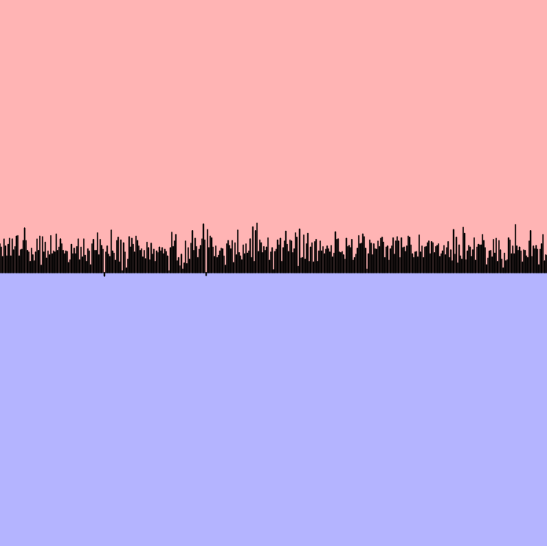
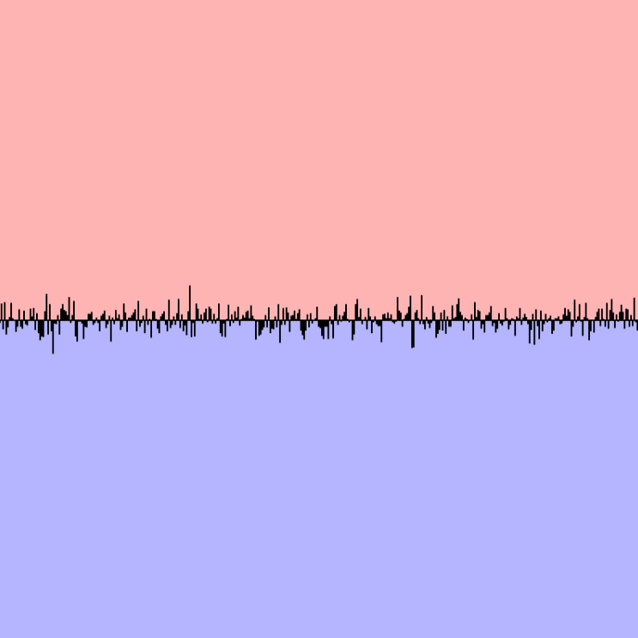
Random Simulations
To the right are two graphs of Red’s win rate over time if each move is determined randomly.
The higher the line, the more red is winning. The lower the line, the more blue is winning.
The top graph is on a 7x7 board. Red’s win rate fluctuates between 50% and 60%, indicating a slight advantage.
The bottom graph is on an 8x8 board. Red’s win rate hovers around 50%, indicating no advantage.

Slide 7
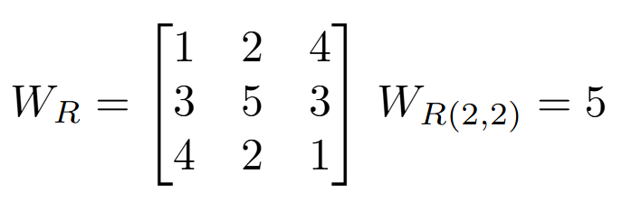
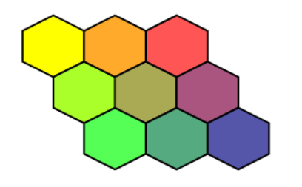
Weight Distributions
We can represent an nxn Hex board with an nxn matrix “W”.
Each entry in W represents a weight associated with a corresponding tile. The larger the weight, the more likely the algorithm is to select that tile as its next move.
The probability of some move (i , j) is equal to its weight divided by the sum of weights.
P(move(i , j)) = W_{(i , j)} / Sum(W)
1
2
4
3
5
3
4
2
1
4%
8%
16%
12%
20%
12%
16%
8%
4%

Slide 8
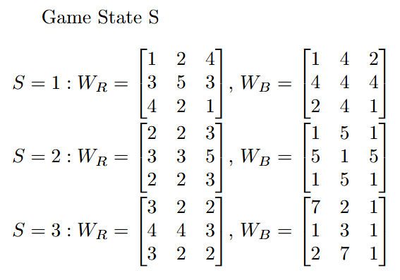
Weight Distributions Continued
Assign each player their own matrix: Red = W_{R}, Blue = W_{B} Furthermore, each player should have one matrix for each game state.
We trained our algorithm with two simple types of game states: turn number and previous move.

Slide 9
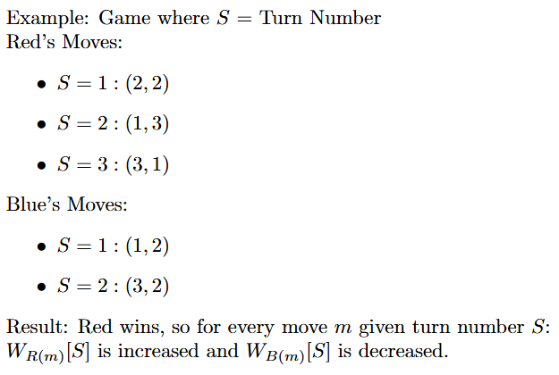
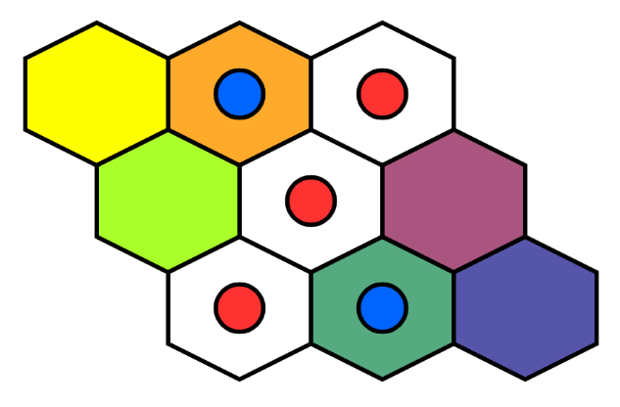
Adjusting Weights
After each move, the game state and the corresponding move are stored.
Once a game ends, the weights for the winner’s moves on each game state are increased while the loser’s are decreased.
Winning decisions become more likely, losing decisions less likely.
W_{R(2,2)}[1] *= 1.02 W_{B(1,2)}[1] *= 0.98
W_{R(1,3)}[2] *= 1.02 W_{B(3,2)}[2] *= 0.98
W_{R(3,1)}[3] *= 1.02

Slide 10
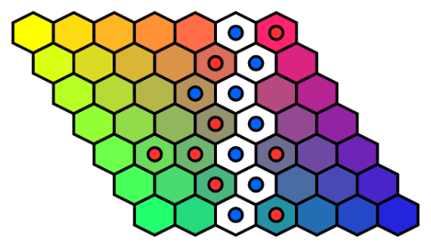
Training Time!
The weights of winning moves are increased by 2% and losing moves decreased by 2% after each game.
We trained on a 7x7 hex board, though our algorithm works for any size board.
Weights are restricted between 1/500 and 500 as to allow all moves to be possible.
Once a tile is marked, all of its associated weights are temporarily set to 0 until the game restarts.

Slide 11
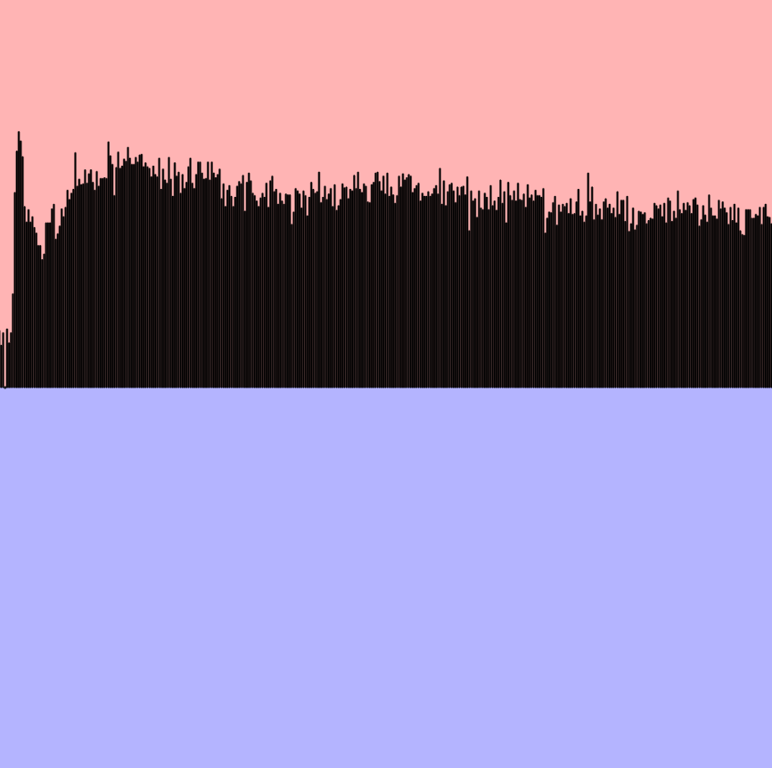
Turn-Based Play Game State = Turn Number
Observations:
Initially, Red’s win rate increases dramatically, then tapers toward 65% or so.
Players favor more and more potential moves as time goes on; they have too many choices.
Turn number isn’t a very informative game state.

Slide 12
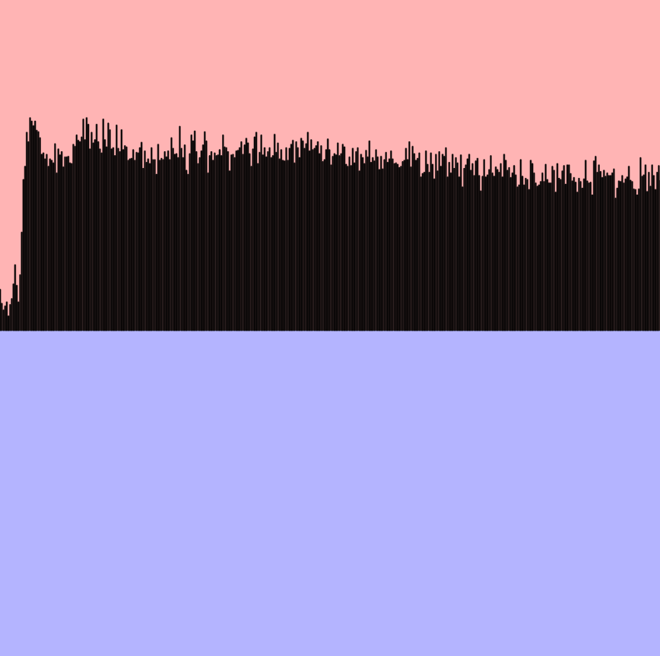
Response-Based Play Game State = Opponent’s Previous Move
Observations:
Red quickly improves initially, but gradually becomes less confident, settling around 75%.
Players only care about moves that are generally more likely to give them a win, so specific responses are less likely to develop. Still, this is an improvement.

Slide 13
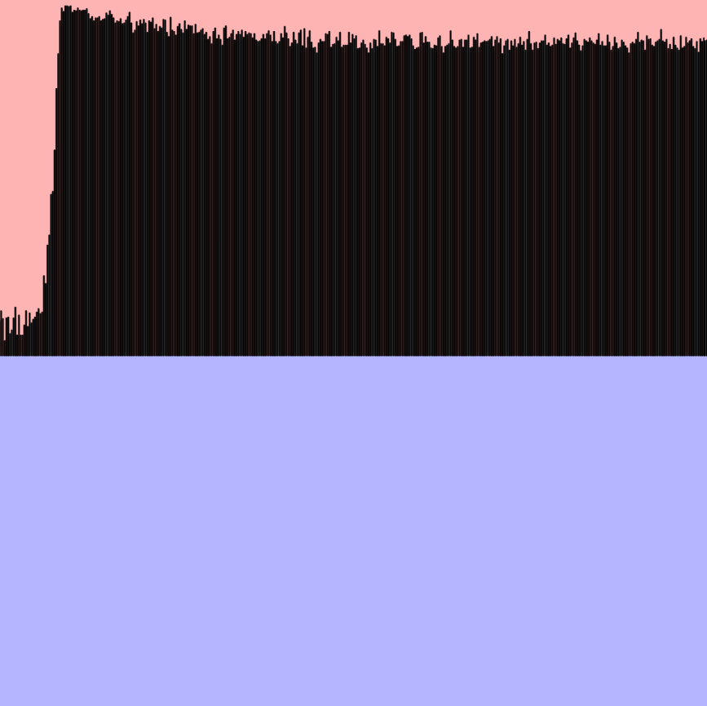
Stronger Punishment Win: +1% Weight, Loss: -2% Weight
Observations:
Red has a drastic improvement, eventually reaching a 98% win rate before tapering to 90%.
Blue reverts to playing randomly because all moves acquire small weights. Similar to learned helplessness.

Slide 14
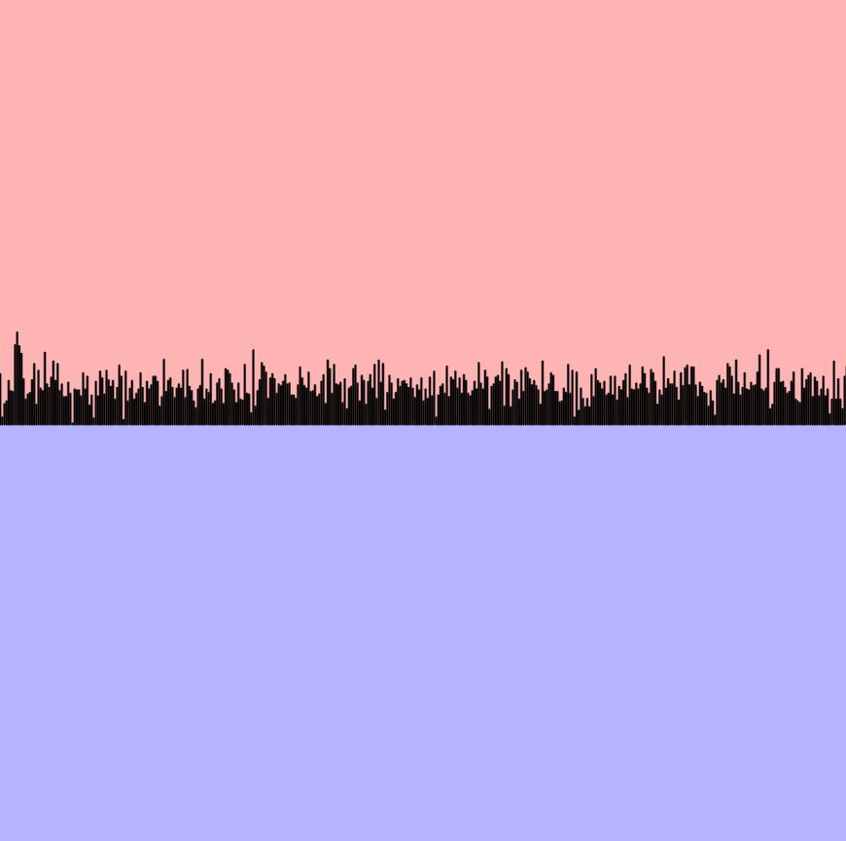
Even Stronger… Win: +1% Weight, Loss: -5% Weight
Observations:
Both players resort to random play rather quickly because losing is punished too harshly. Interestingly enough this graph demonstrates that red has an inherent advantage by going first – at least on a board with odd dimensions.

Slide 15
Dynamic Reinforcement
So far, weights have been adjusted according to constants. Now we will adjust them based on win rate. For each player, a higher win rate results in harsher punishment, whereas a lower win rate results in softer punishments.

Slide 16
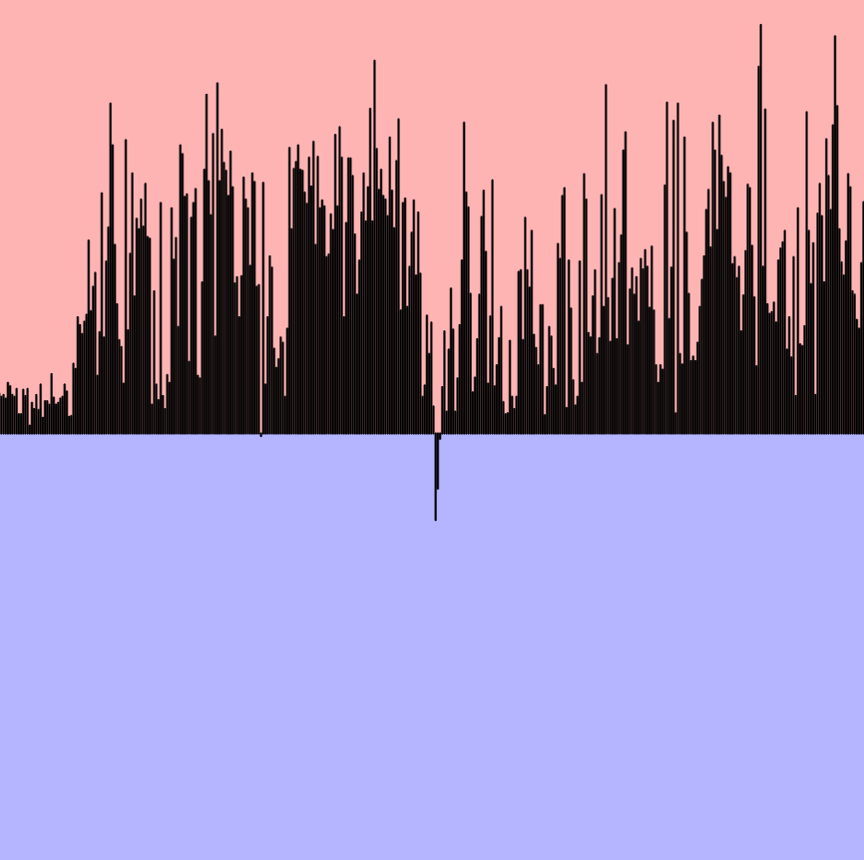
Dynamic Reinforcement More wins, stronger punishment.
Observations:
The win rate swings wildly because both players update their strategies often.
Players often abandon good responses for the sake of a new strategy that throws the other player off.

Slide 17
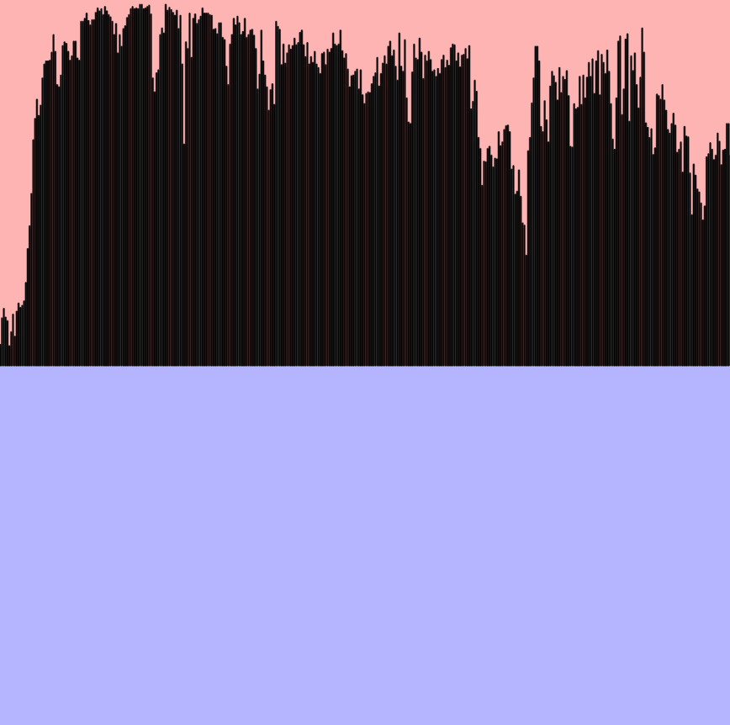
Stronger Early Moves Earlier moves are rewarded/punished more.
Observations:
Red can win much more consistently, though dampened swings still occur.
Nevertheless, Blue never resorts to random play. Good responses aren’t forgotten despite consistent losses.

Slide 18
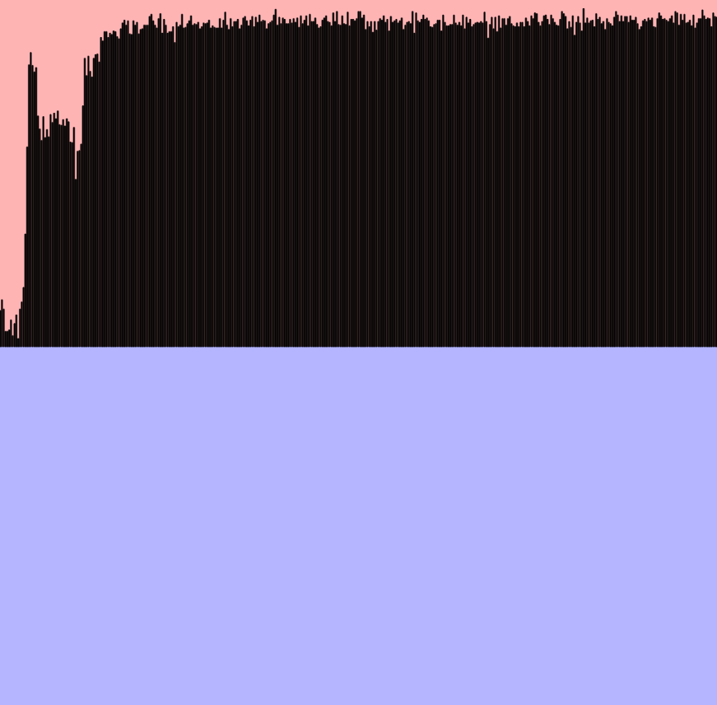
Stronger Late Moves Later moves are rewarded/punished more.
Observations:
Swinging eventually goes away, Red maintains 95% win rate.
Blue has some clear responses and some random ones, depending on how successful Red’s moves are.

Slide 19
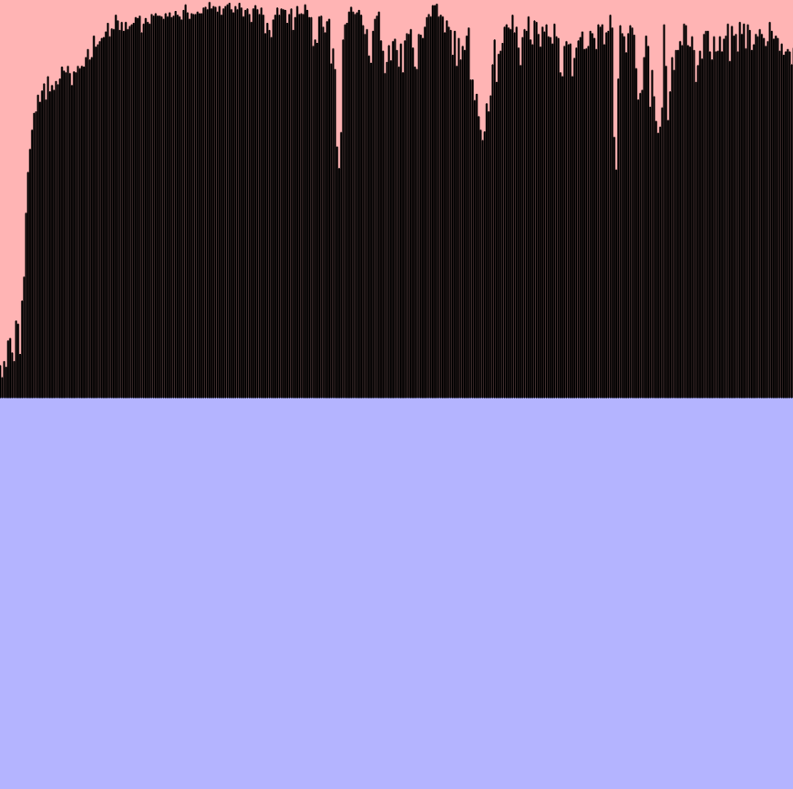
Stronger Early & Late
Observations:
Red can reach even more consistent winning streaks, peaking at 99%.
Blue has fewer random responses.
Swings occur, though they are less dramatic.

Slide 20
Factoring More Moves
Looking more than one move into the past may result in better moves. To do this efficiently, we can multiply weight distributions together, thereby making responses that work well for all of the previous moves more likely.

Slide 21
2 Previous Moves Exponents: 1, 1/2
Observations:
Remarkably stable win rate for Red that hovers around 93%.
Blue rarely responds randomly and has a number of well-developed responses.

Slide 22
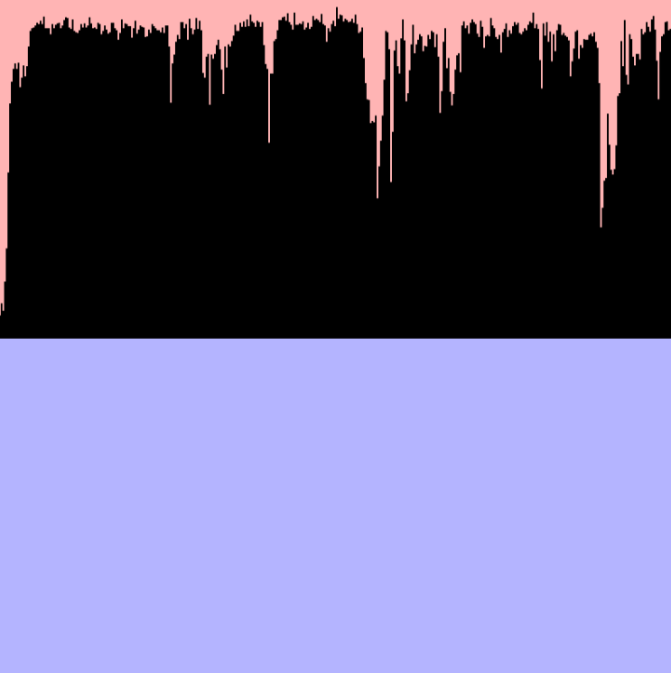
3 Previous Moves Exponents: 1, 1/2, 1/3
Observations:
Red’s win rate fluctuates more, though has higher peaks at around 97%.
Players follow a pattern of clustering moves together.

Slide 23
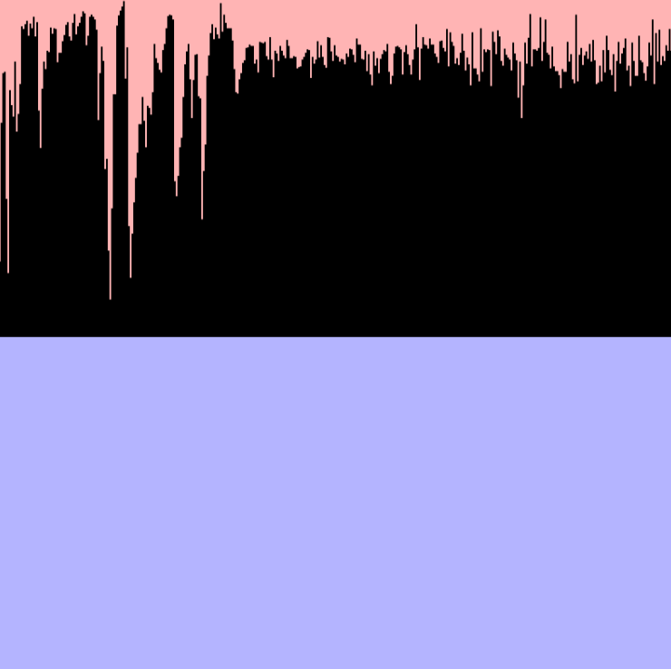
4 Previous Moves Exponents: 1, 1/2, 1/3, 1/4
Observations:
Even more fluctuation, even higher peaks.
Clustering behavior is more prevalent. The most likely plays are ones that neighbor multiple previous plays.

Slide 24
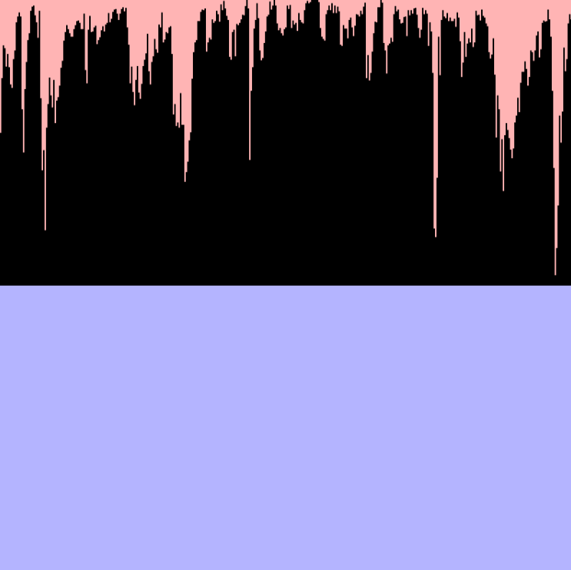
5 Previous Moves Exponents: 1, 1/2, 1/3, 1/4, 1/5
Observations:
Red’s win rate reaches 100% a couple of times, though it cannot stay high for long.
Few moves serve as good responses to 5 previous moves. Once those moves are found, they are quickly overridden by a different playstyle.

Slide 25
Live Demonstration

Slide 26
Where to next?
So far, we’ve only trained the AI against itself. We would like to try playing against it ourselves to look for strategic patterns.
We could try training on more informative game states (pairs of previous moves, for example), though this may require more computing memory.
More research on other AI models (AlphaGo, Monte Carlo Tree Search) and human-developed strategies.
Bake certain strategies into the model and see how it builds off them (forcing sequences of moves at the beginning).

Slide 27
Sources
HexWiki, Hexwiki.net. (2023). https://www.hexwiki.net/index.php/Main_Page.
AlphaGo, Google DeepMind. (2024). https://deepmind.google/research/breakthroughs/alphago/.
GeeksforGeeks, ML | Monte Carlo Tree Search (MCTS), GeeksforGeeks. (2019). https://www.geeksforgeeks.org/ml-monte-carlo-tree-search-mcts/#.
Yang, Jing (2001). https://webdocs.cs.ualberta.ca/~hayward/papers/yang7.pdf.
Thank you! Any questions or suggestions?

